Slide 1
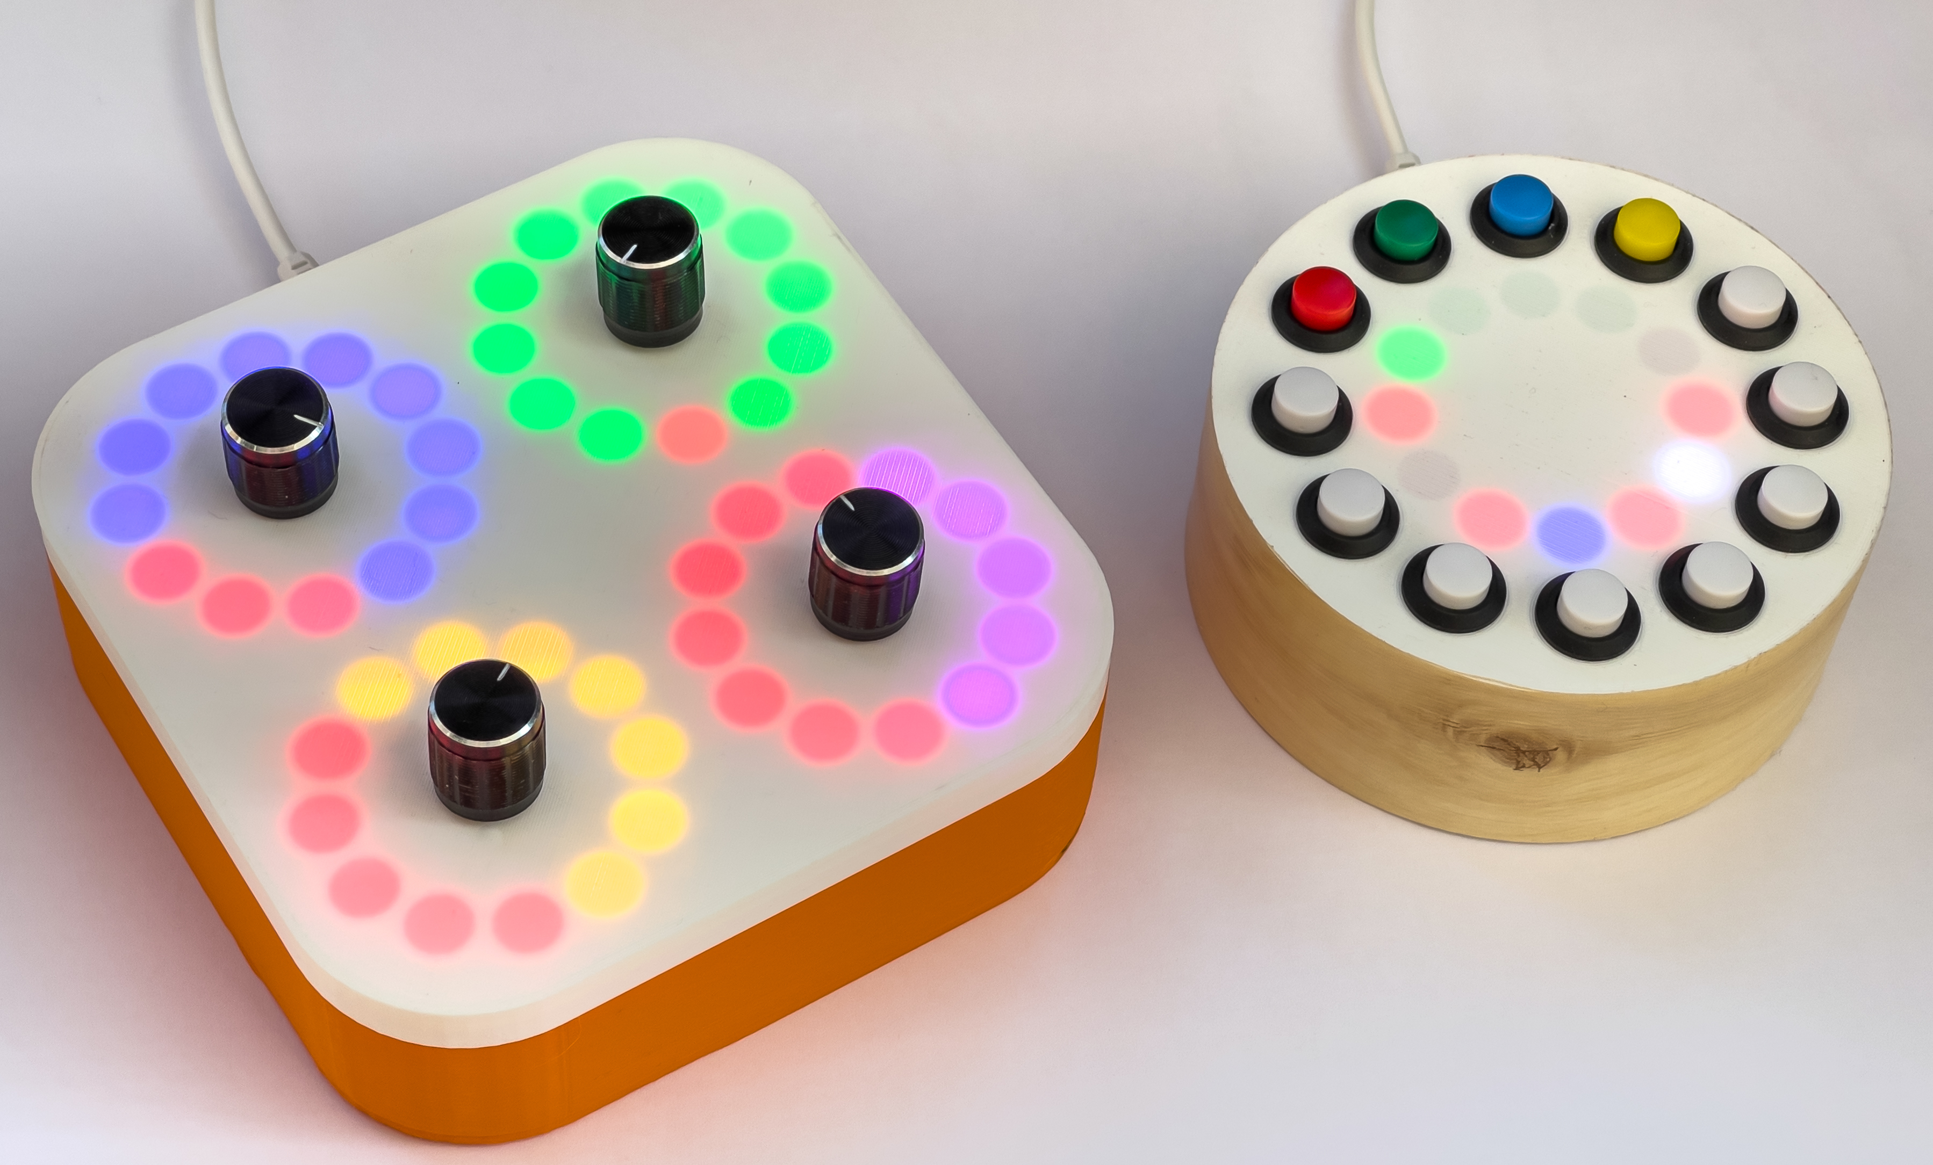
Make your own musical instruments with Python and Pure Data
Rob Miles
www.robmiles.com
@robmiles

Slide 2
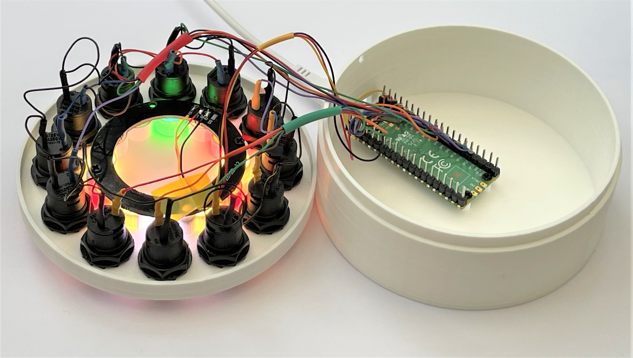
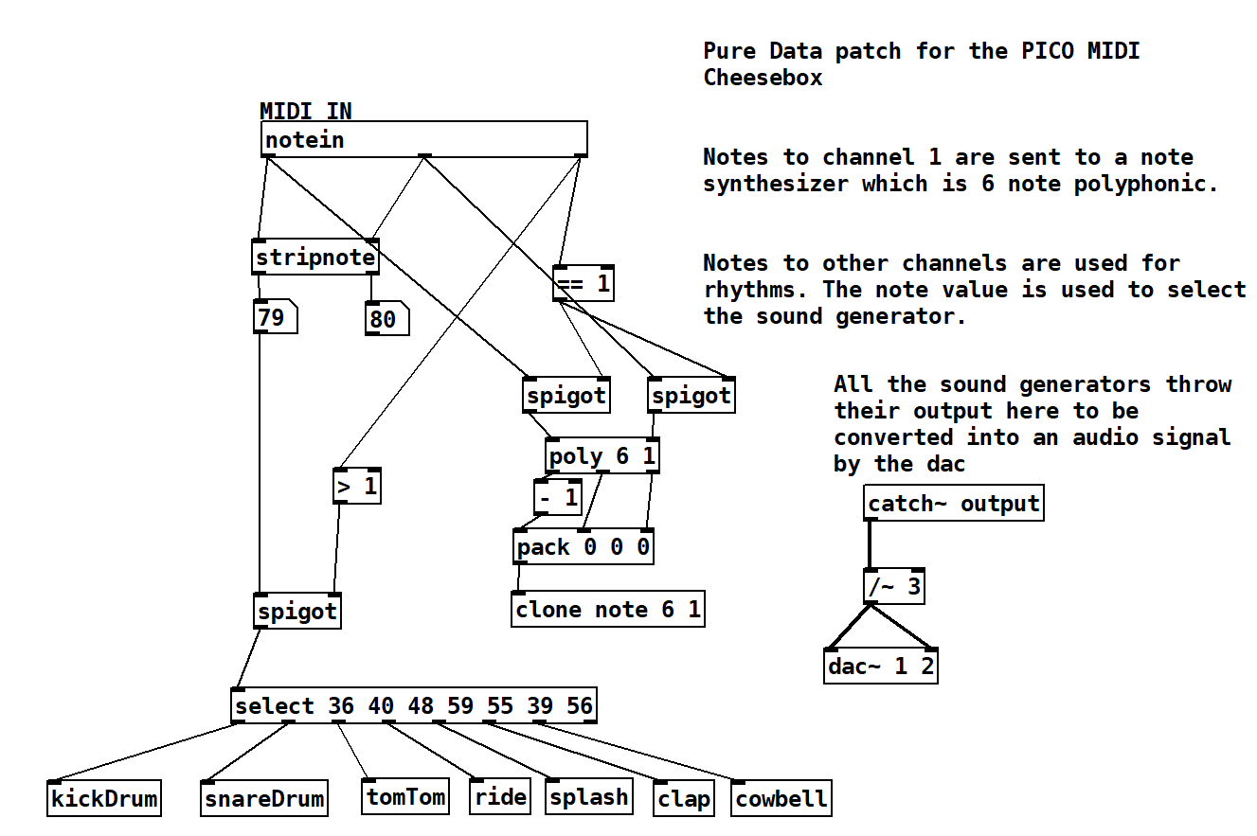
Overview
About Rob
Pure Data
Making sound from maths
MIDI messages and music
Making a Synth
Fun with hardware
Making music hardware
The Raspberry PI PICO
Circuit Python
Talking MIDI
The PICO MIDI CheeseBox
The PICO Crackers Controller
Summary

Slide 3

About Rob:
Taught Computer Science at Hull University
Spent many years twisting minds and crushing dreams
A Microsoft MVP
Blogs at: www.robmiles.com
Tweets at: @robmiles
Writes books….

Slide 4
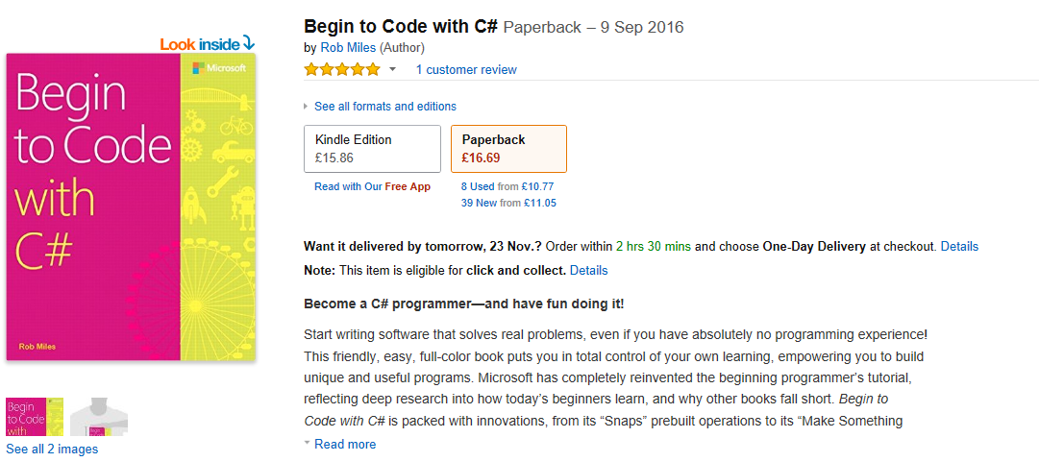
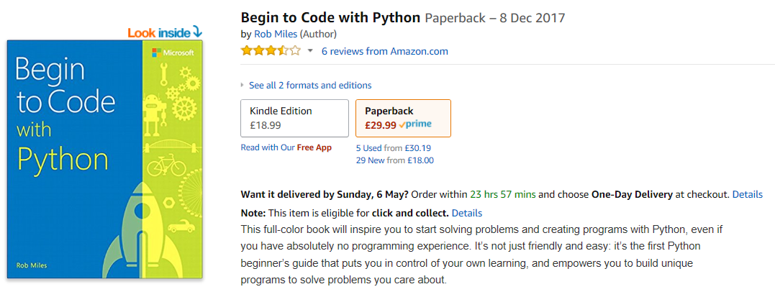
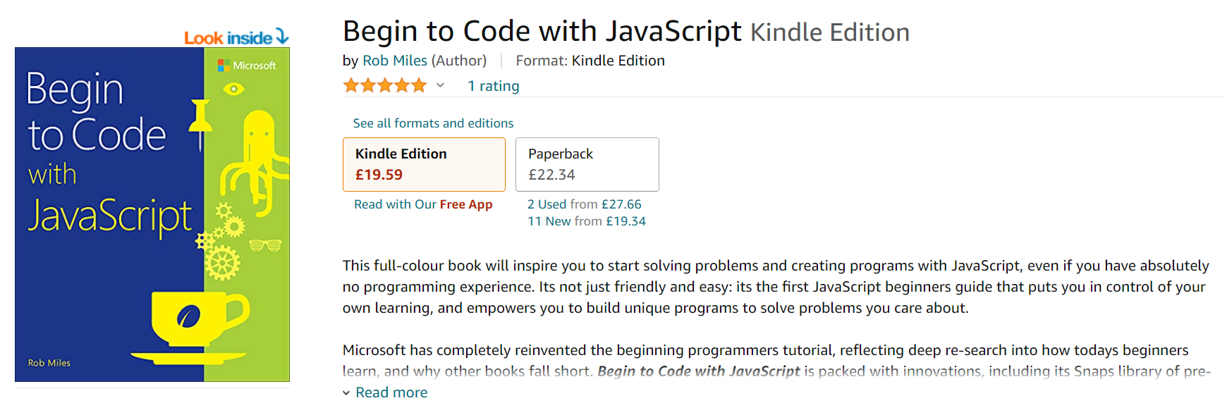
Begin to Code with C#

Slide 5
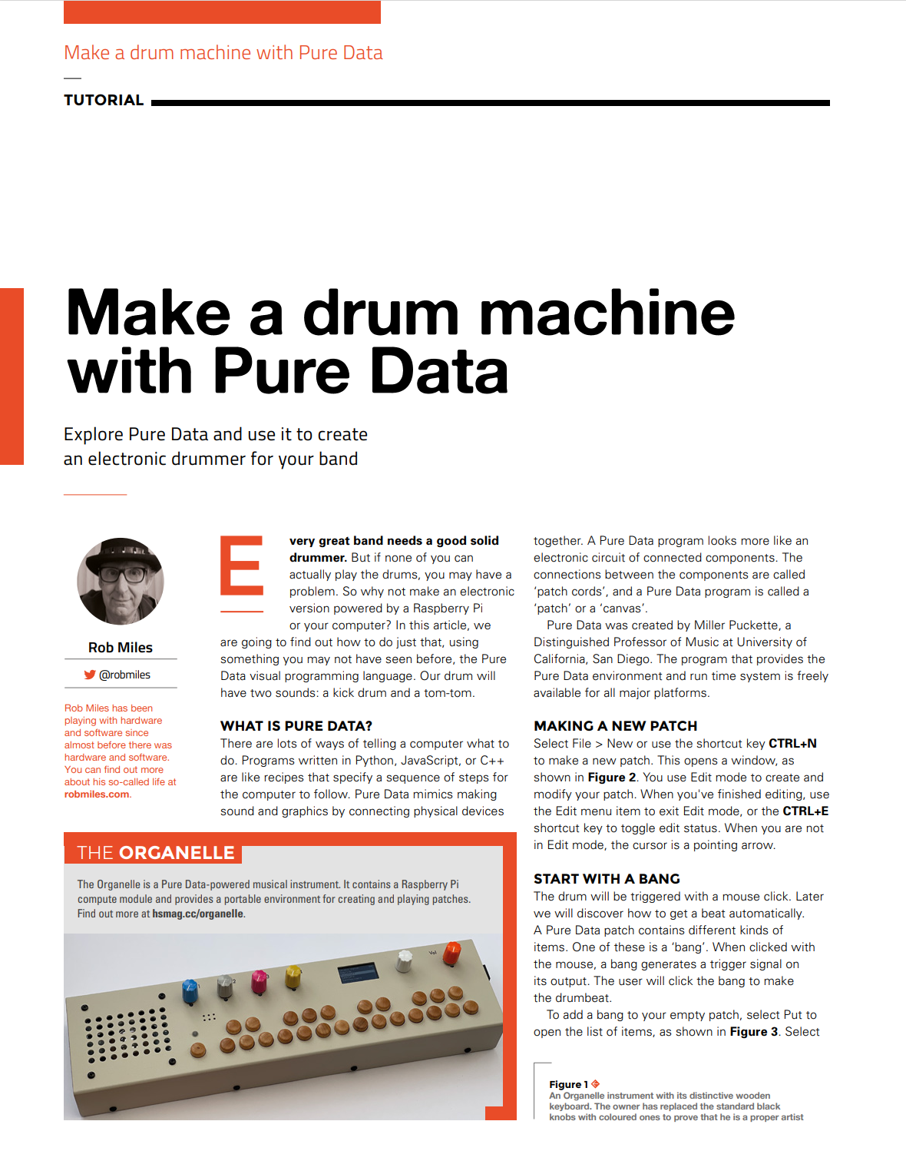
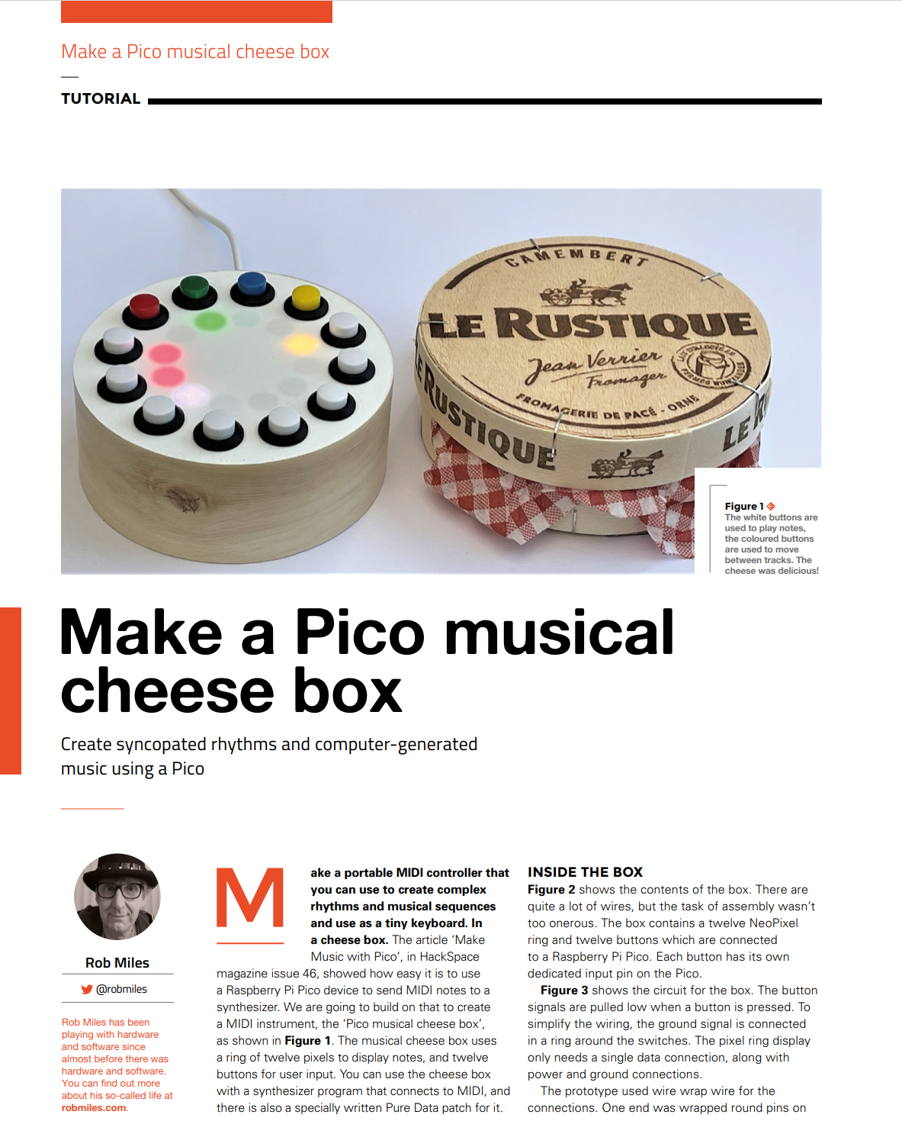
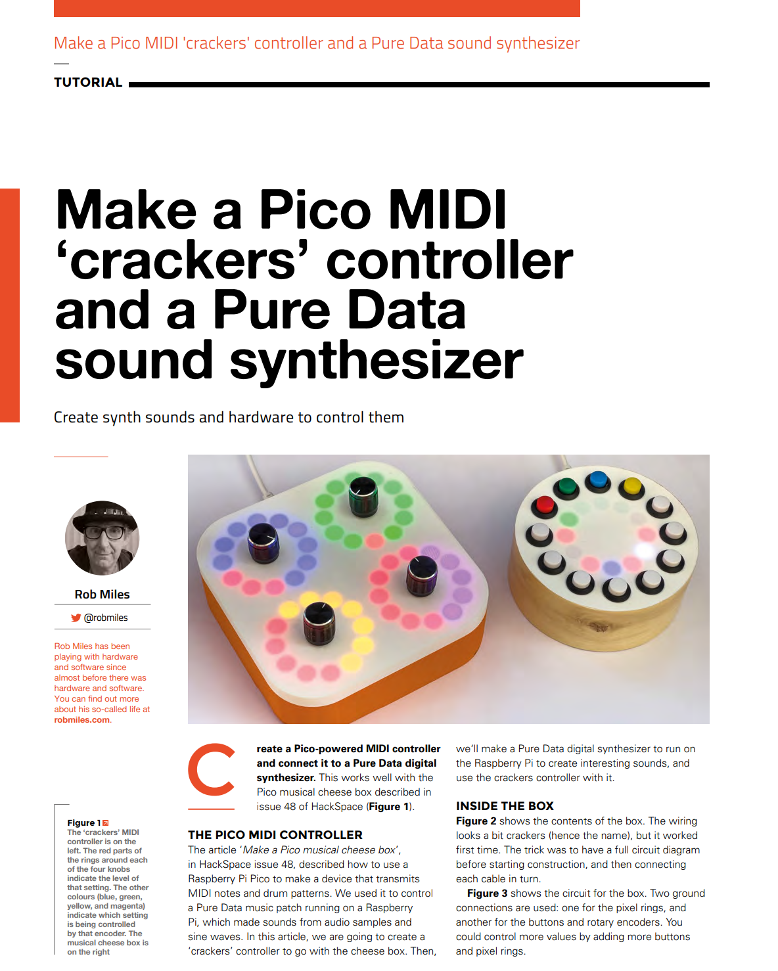
HackSpace
HackSpace magazine is a fantastic read
And you can read it for free ☺
You can find out more about this project in issues 47-49
hackspace.raspberrypi.com/issues

Slide 6
Pure Data

Slide 7
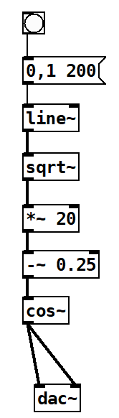
Making sounds with software
You can process sound signals using procedural code
If you want to try this, take a look at SuperCollider: https://supercollider.github.io/
However, this only works if you already know how to program
We are going to take a look at a platform called Pure Data
This provides a graphical sound processing environment in which you create signal processing behaviours by linking objects together

Slide 8
Pure Data
Pure Data has been around for many years
Pure Data programs are called “patches”
They are comprised of software objects linked by “patch cords”
The Pure Data program provides a graphical environment where you “wire up” the objects
There are objects that represent input and outputs
It is a great way to explore object oriented design
You can make your own objects and add them to a patch
There are also lots of community patches available

Slide 9

Getting Pure Data
You can download Pure Data from here for free:
puredata.info
There are versions for Windows, Mac, Linux and Raspberry Pi
They all run as a graphical application which you use to create the code

Slide 10
Work through 1: Let’s make a drum
We can start by making a digital kick drum using Pure Data

Slide 11

Making a kick drum
We are going to use Pure Data to create a kick drum sound
The kick drum is produced by a waveform that will be created by software
Kick drums start with a high pitched thump followed by a lower pitched sounds as the drum resonates

Slide 12
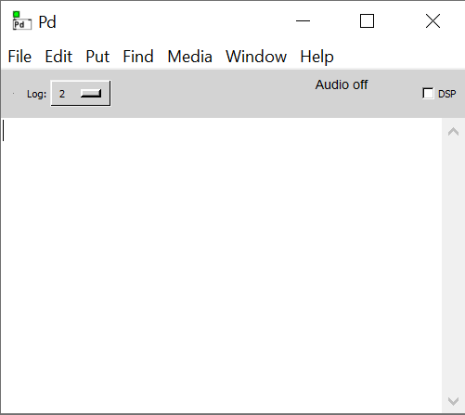
Starting
Pure Data runs as a graphical application which you use to create the code
When you start the program you get the console
You can’t use this for patches, you just use it to manage the application
Lets start with File->New to open an empty patch

Slide 13


Edit and Run Mode
When you’re working on a patch you can be in “edit” or “run” mode
In edit mode the cursor is a hand
In run mode the cursor is an arrow
You can only add objects and connections when in Edit mode
You toggle between edit and run by pressing CTRL+E
Run
Edit

Slide 14
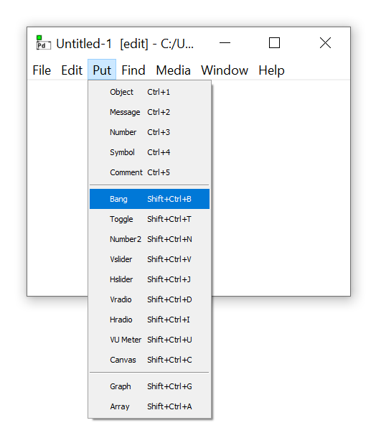
Bang object
Pure Data programs are made up of patches
You add objects to the patch and then link them together
We are going to start with a trigger object called a Bang
We select the Bang object from the Put menu

Slide 15
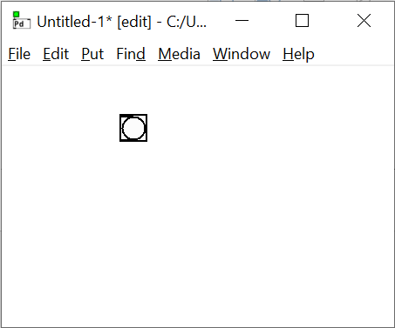
The Bang object
When the patch is running we can click on the Bang object to send a message out of the bottom of the object
The message will trigger another object to do something
We make the program run by connecting outputs to inputs

Slide 16
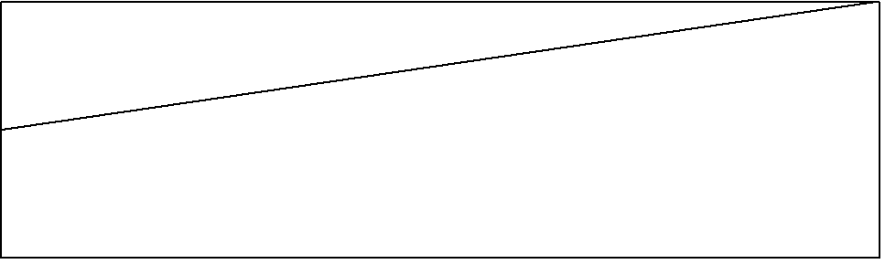
Creating a line
We start with a waveform that is expressed as a line that goes from 0 to 1 over 200 milliseconds
200 milliseconds is the length of the sound that we want to make – that’s a fifth of a second
We will use the Pure Data line object to make this line
We need to create a message to tell the line what waveform to make

Slide 17
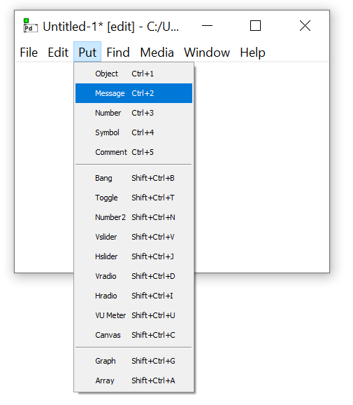
Make a message
We start by putting a message object into the patch
This is a special object type that we can find in the Put menu

Slide 18
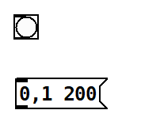
Make a message
The message object can contain multiple messages
We want to send two messages to line
The first message is the value 0
This is the start level for the line
The second message is the value pair 1,200
This is the end level and the duration in milliseconds of the line

Slide 19
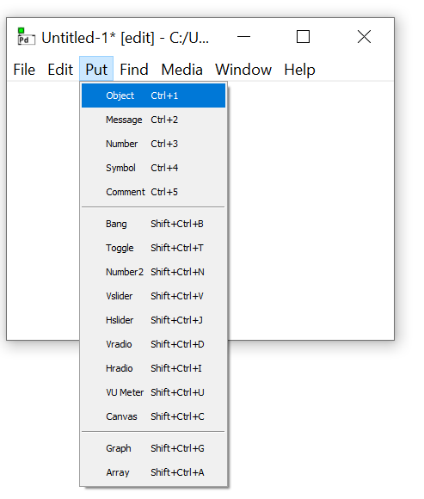
Add a line
There is no pre-set object for the line object
We make an empty object and then specify that it is a line

Slide 20
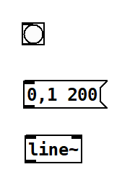
Lines make audio signals
The output of a line is an audio signal
This is signified by the addition of a ~ character on the end of the object name
We could send this signal to a speaker if we wanted
But it wouldn’t sound like much
The speaker cone would just move outwards over a fifth of a second

Slide 21
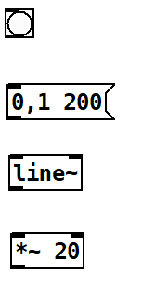
Make an interesting sound
I want the sound to contain 20 cycles
This will make the speaker go in and out 20 times
I can do this by multiplying the output of line by 20
This multiplies each value in the audio signal by the value as they pass through the object

Slide 22
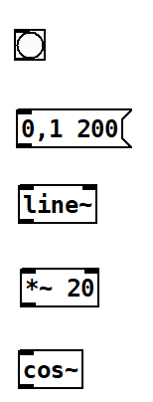
Create a sine wave
The next thing we do is take the “cosine” of the signal as it goes through
The cos object multiplies the incoming values by 360 degrees and then takes the cosine of that value
This means we get a cosine wave that goes between -1 and 1
We can use that to make a sound

Slide 23
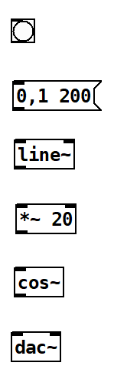
Digital to Analogue conversion
The dac object takes in a stream and sends the values to the sound output on the computer
It has two inputs, one for left and another for right

Slide 24
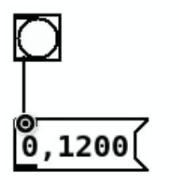
Wiring it up
We add wires by clicking on the output of an object (the thick lines) and then dragging the end of the connecting line to the input of another
We can change these connections later
An output can be connected to multiple inputs

Slide 25
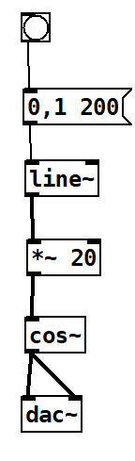
The final circuit
This is the final circuit
Note that the output from the cos~ is sent to both the left and right inputs of the adc~
Note also that the connections that carry the audio signal are drawn as thicker lines
This drum sounds rubbish
We need to make the waveform more interesting

Slide 26
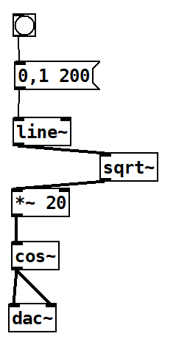
Better sound through mathematics
We can make the sound more interesting by using some maths
If we take the square root of the values in the line we get something that rises more quickly and then tails off
This will give us a much nicer drum sound

Slide 27
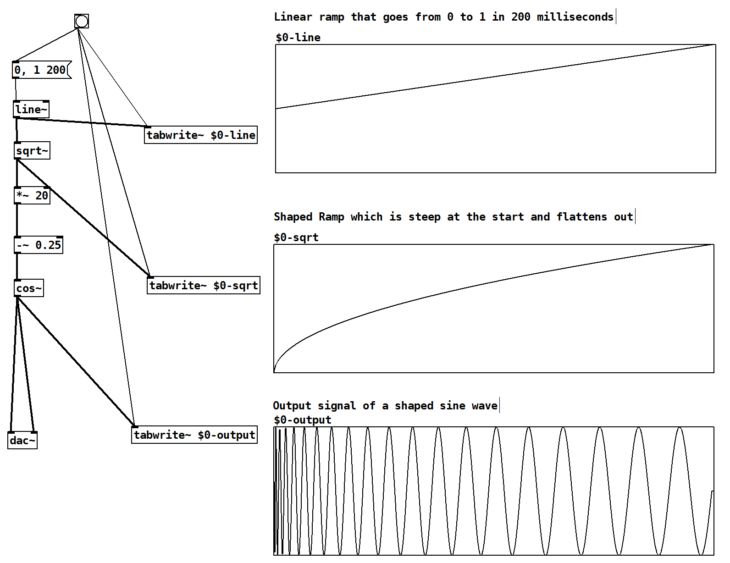
Signals
Pure Data can draw graphs of the audio signals
You can see that the line becomes a curve when we take the square root of the values
which makes a more interesting sound wave

Slide 28
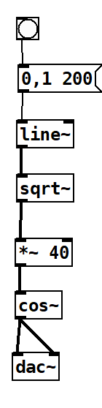
Change one number…
We can make a higher pitched “tom tom” sound just by changing the number of waveforms that are made
You can have a lot of fun just trying more numbers and doing more ramp shaping
You can also add noise and mix signals together

Slide 29
MIDI messages

Slide 30
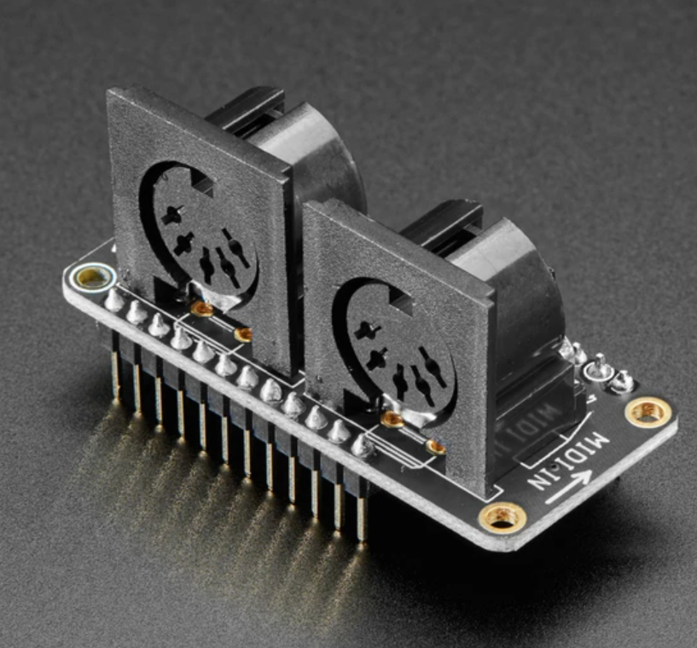
MIDI connections
The MIDI standard dates from the 1980s
It sends note on and note off messages along with control changes on 16 channels
It originally used funky DIN connectors and opto-isolators to connect devices
Nowadays we can use USB instead
Pure Data can receive note information from MIDI

Slide 31
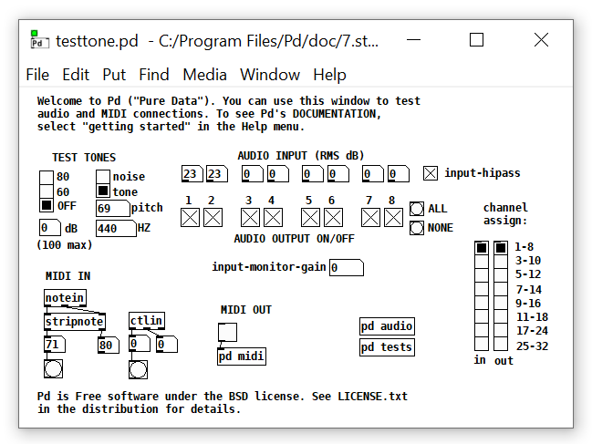
Pure Data Tester
Pure Data has a test patch you open with Media->Test audio and MIDI
This shows the MIDI messages as they arrive and will also produce test audio output
The notein object is the one that receives MIDI messages
The stripnote object removes the note value and the volume

Slide 32
Work through 2: Let’s make a synthesizer
Let’s make a simple MIDI synth from scratch

Slide 35
PICO and MIDI

Slide 36
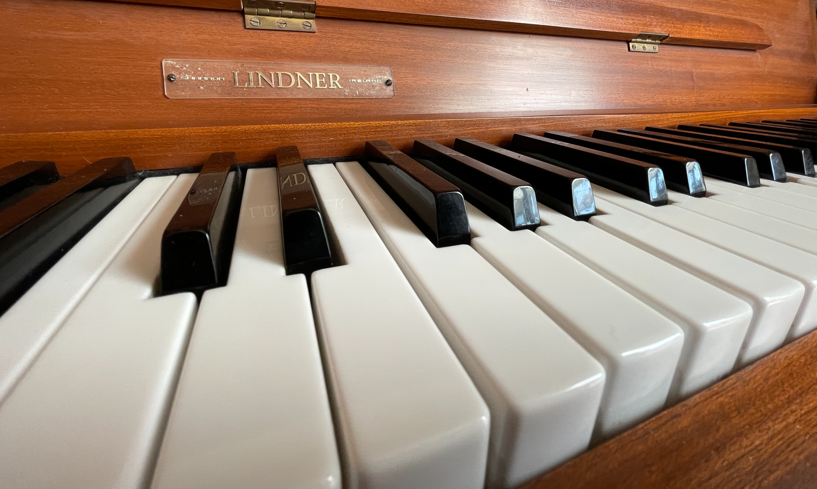
Music Hardware
Flashing lights and making beeping noises is all very well, but what about making music?
We can make an embedded device into a MIDI device
Lots of keyboards (and computers) understand MIDI (Musical Instrument Digital Interface)
We can make something that sends note messages to control the sound output of synthesizers and keyboards

Slide 37
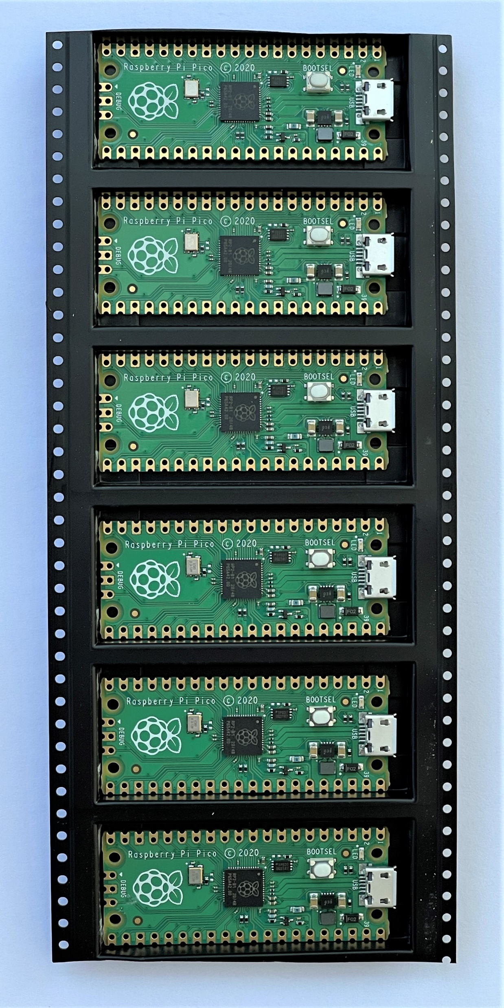
Raspberry Pi PICO
The Raspberry Pi PICO is a great device for embedded projects
Dual core processor, lots of EEPROM and ram
It run Circuit Python which has built-in support for MIDI messages
They are only a few pounds each and they have loads of hardware connections

Slide 38
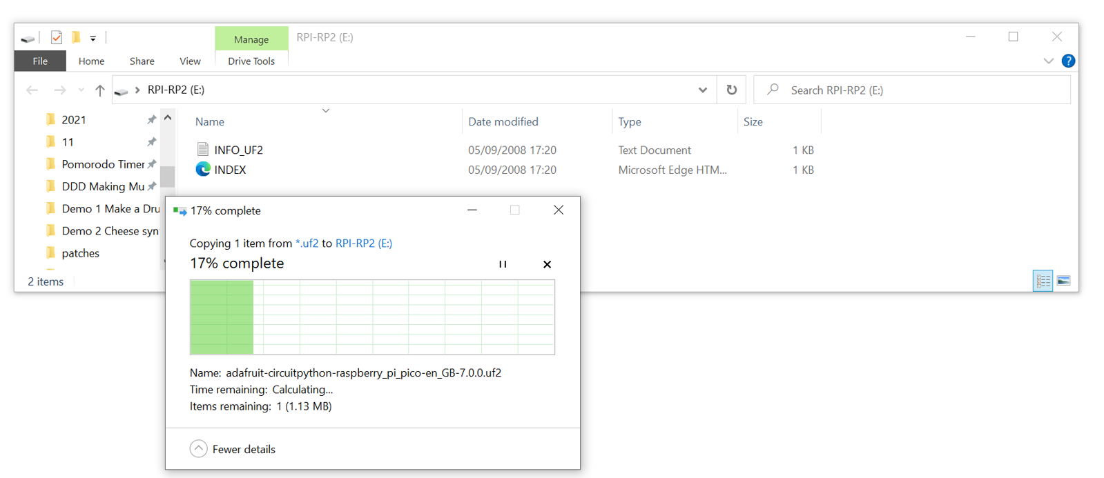
Installing Circuit Python
Circuit Python is a free download from circuitpython.org/board/raspberry_pi_pico/
Hold down BOOTSEL on your PICO when you plug it in and it will appear on your PC as a mass storage device
Drag the firmware image into that storage to install it
It then appears as another device running Circuit Python

Slide 39
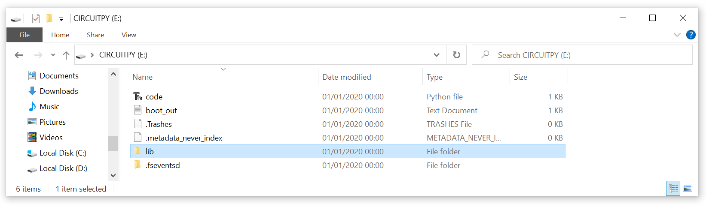
The Circuit Python storage device
code.py is the program that runs when the device starts
You can store data and other programs on the device too
The lib folder holds any libraries that your application needs
We need to add some to libraries to support MIDI output

Slide 40
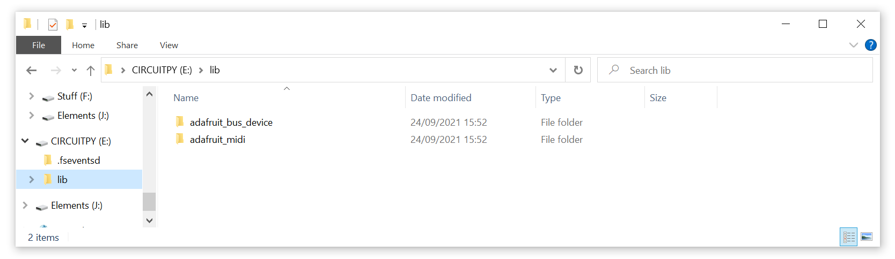
Installing libraries
To use MIDI with Circuit Python you need to install some extra libraries
You can find them here:
circuitpython.org/libraries
They are installed by dragging into the lib folder

Slide 41
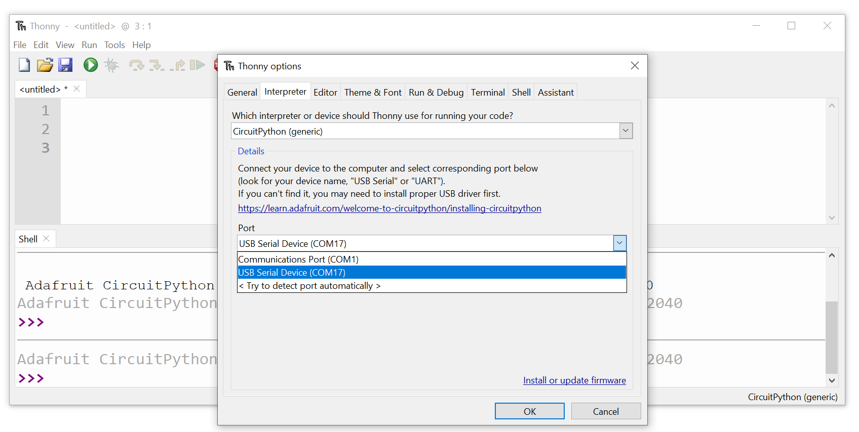
Thonny
I use an app called Thonny to edit and deploy the Python code
It is freely available for lots of platforms from thonny.org
You connect it to the embedded device

Slide 42
MIDI send
This Python code sends MIDI note messages
It imports the libraries, creates a MIDI object and then uses it to send 10 note values
Note that the program is sending messages to the MIDI port and the serial port over a single USB connection
import usb_midi
import adafruit_midi
from adafruit_midi.note_on import NoteOn
from adafruit_midi.note_off import NoteOff
import time
midi = adafruit_midi.MIDI(midi_out=usb_midi.ports[1],
out_channel=0)
for note_number in range(66,72):
print("Playing:",note_number)
midi.send(NoteOn(note_number, 80))
time.sleep(0.5)
midi.send(NoteOff(note_number,0))

Slide 43
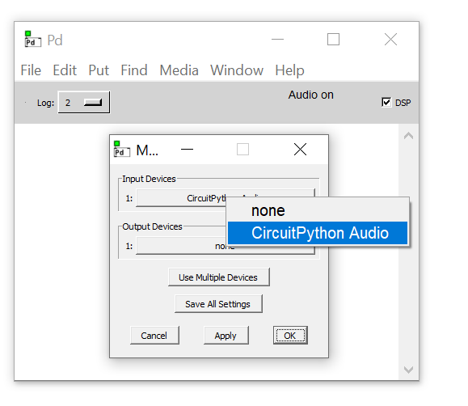
Pure Data Configuration
We have to configure Pure Data to receive the MIDI notes from the PICO
Go to File->Preferences->MIDI to open the MIDI settings dialog
The PICO turns up as “Circuit Python Audio”

Slide 44
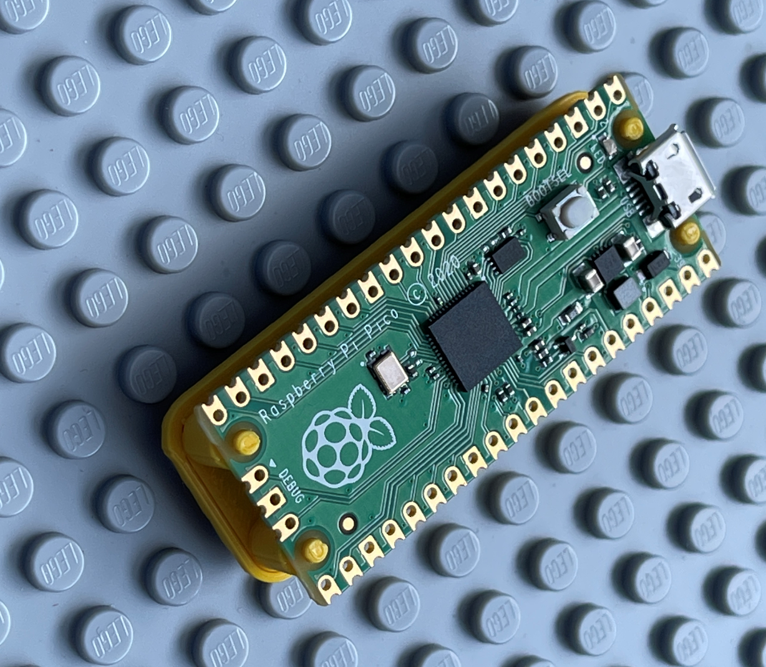
Demo: 2 MIDI from PICO
A Python program that plays notes
Notes:
Connect the PICO to Thonny.
Explain that a Circuit Python device appears as a disk drive.
Show the contents of the disk drive, including the lib folder.
Explain that we can drop Python library files here which can be used by the application.

Slide 45
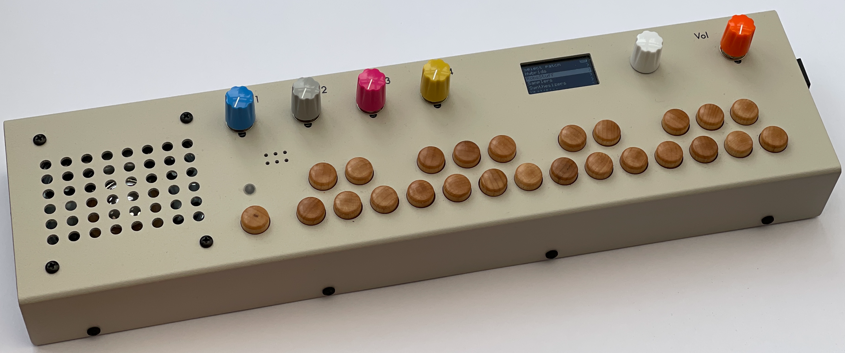
Pure Data is awesome
You can load samples into patches and process them
You can create multiple instances of note generators
All patches run simultaneously and can pass values between each other as they run
There are drivers that can talk to hardware
There are even musical instruments based on Pure Data

Slide 46
Controlling Pure Data
You can control Pure Data using PC keyboard
You can trigger sounds from key presses
You can feed sound data into a Pure Data patch so you can create effects processors
You can also control Pure Data using a protocol called MIDI
Musical Instrument Digital Interface
That is what we are going to do next

Slide 47
The PICO MIDI CheeseBox and Crackers Controller

Slide 48
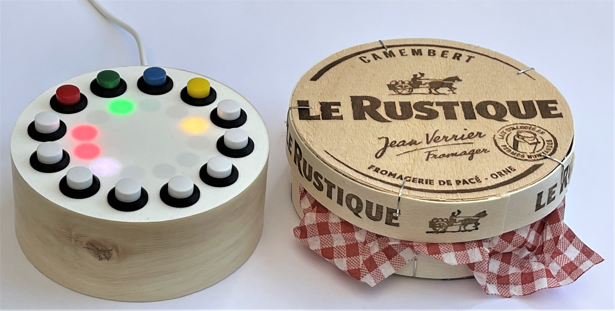
The PICO MIDI CheeseBox
This is a MIDI device that sends notes to any MIDI equipped device
It is controlled via buttons and lights
It is powered by a Raspberry Pi PICO and 500 lines of Circuit Python
It provides a four channel sequencer and keyboard

Slide 49
The PICO MIDI CheeseBox
You can buy MIDI keyboards and controllers
They send MIDI messages when you press keys and turn dials
I thought I’d make my own MIDI device using a PICO, a ring of LEDS and 12 pushbuttons
It is powered by a Raspberry Pi PICO and 500 lines of Circuit Python
It provides a four channel sequencer and keyboard
You can play it as a keyboard, or you can make it sequence notes

Slide 50
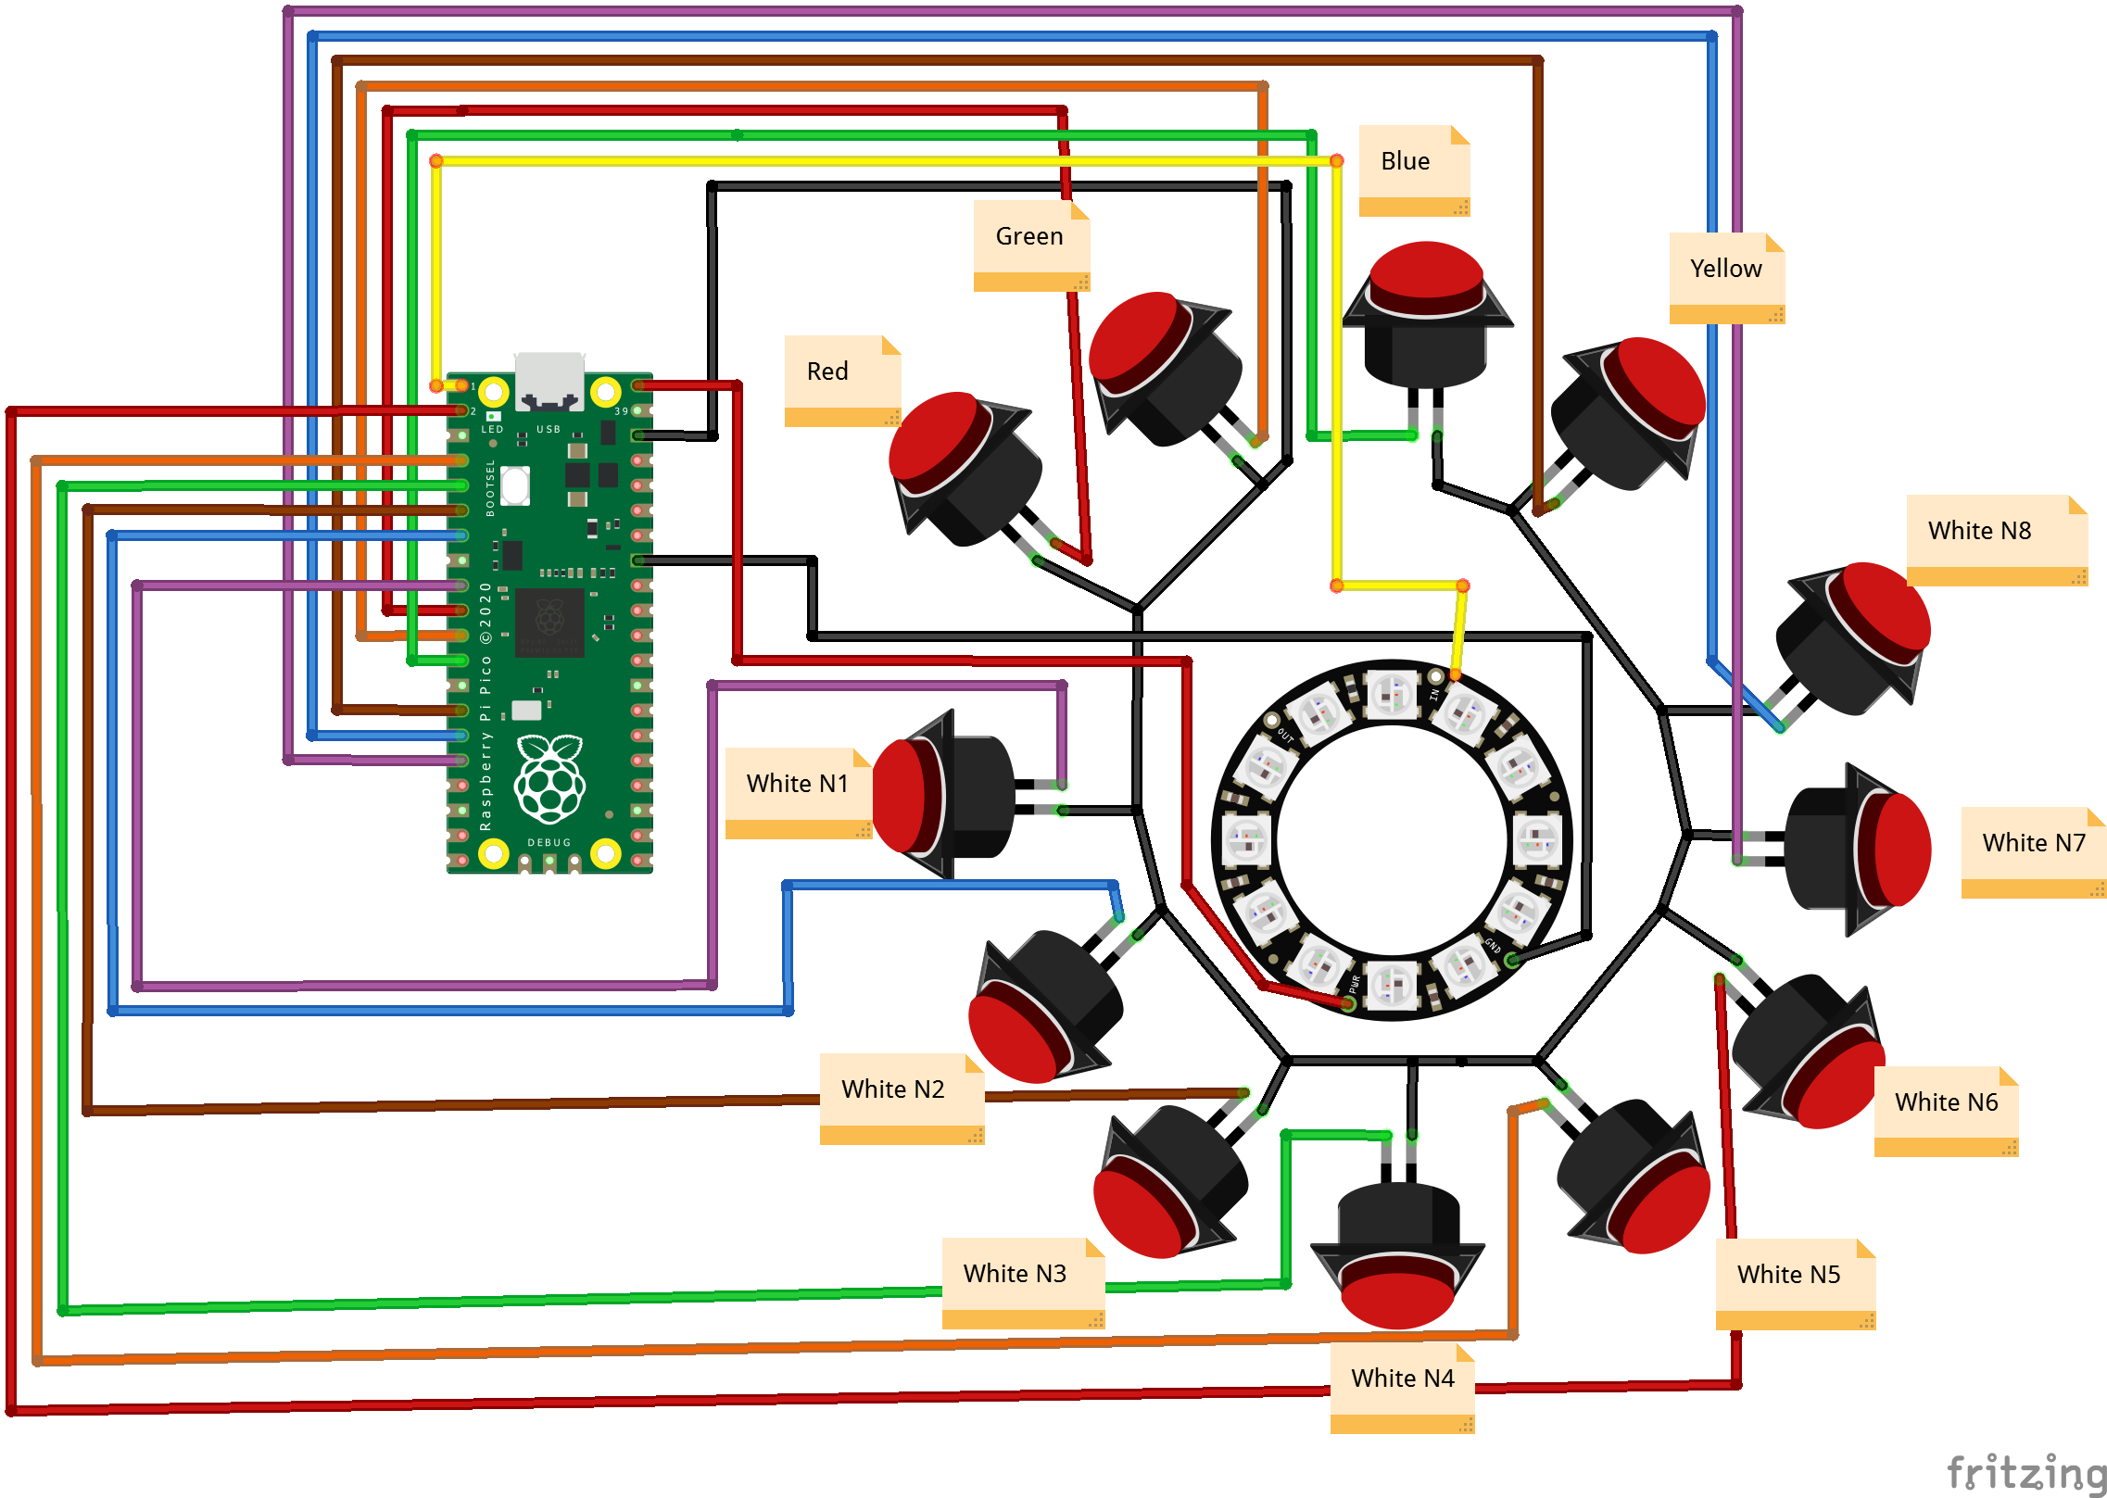
Circuit Diagram
I want to show you this because it took ages to draw…
There are 12 buttons and a 12 light pixel ring

Slide 51
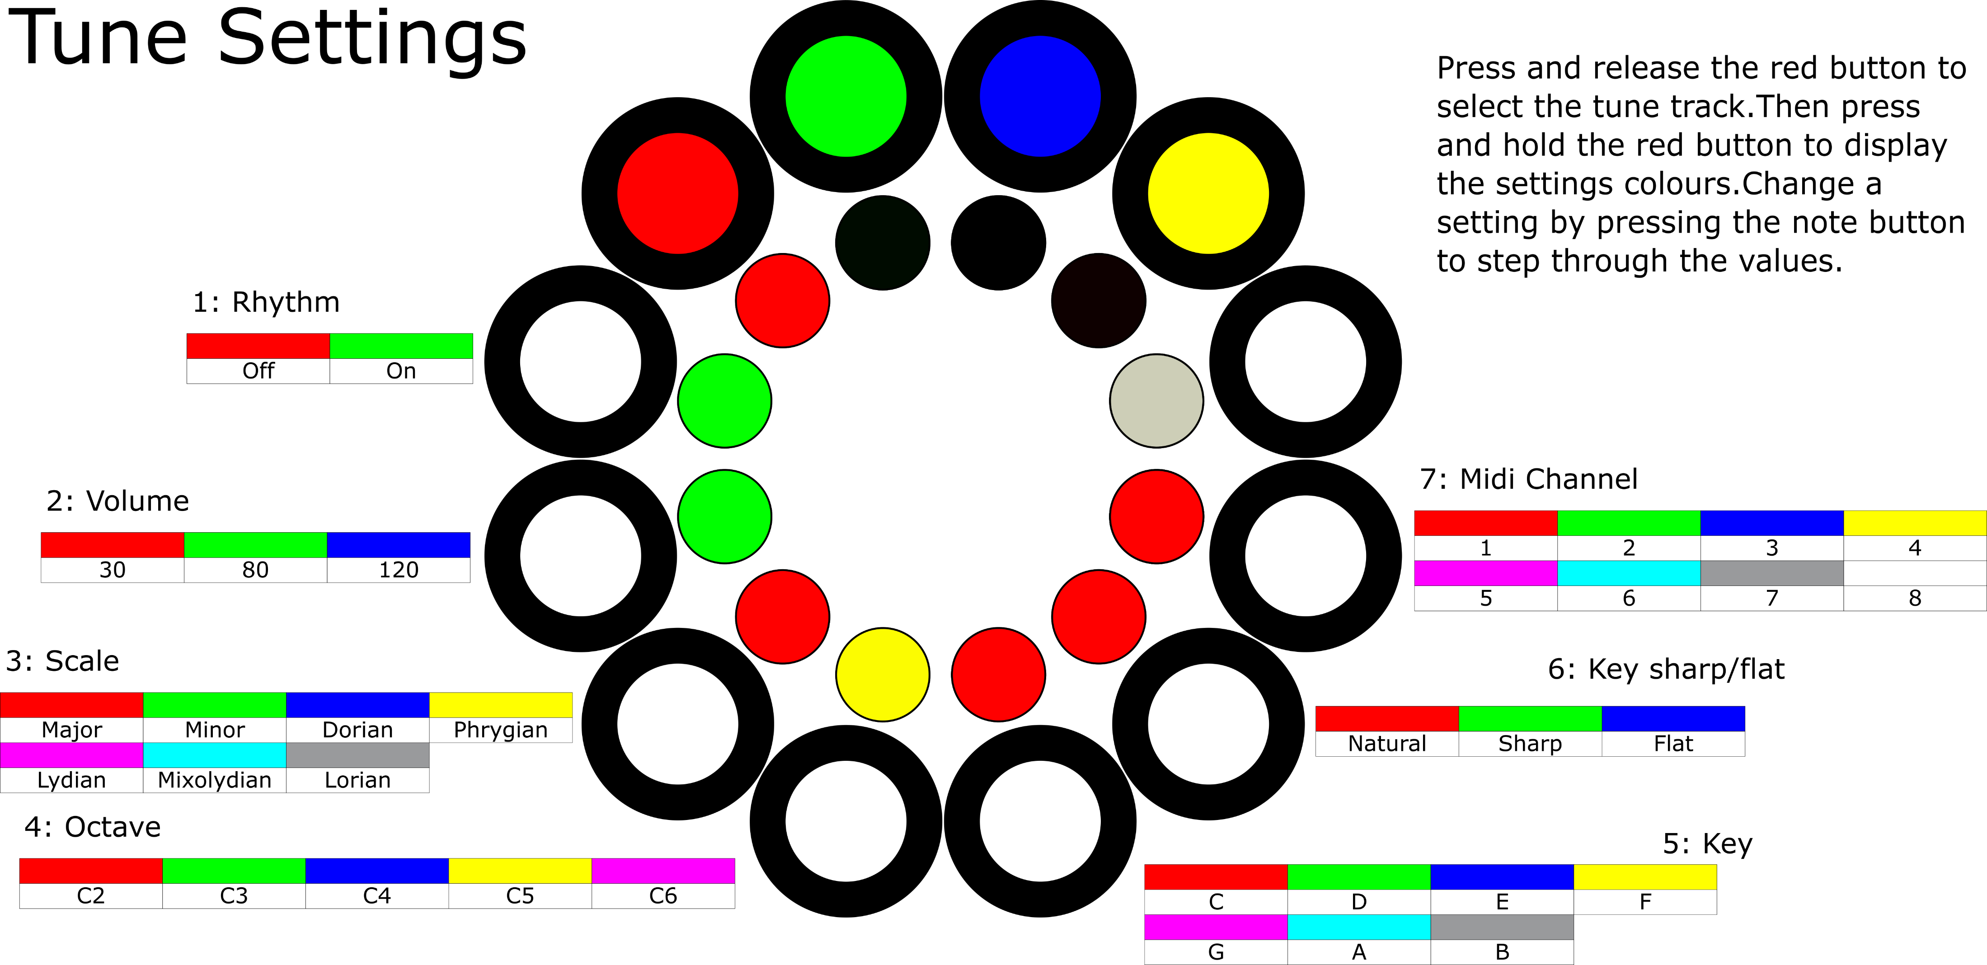
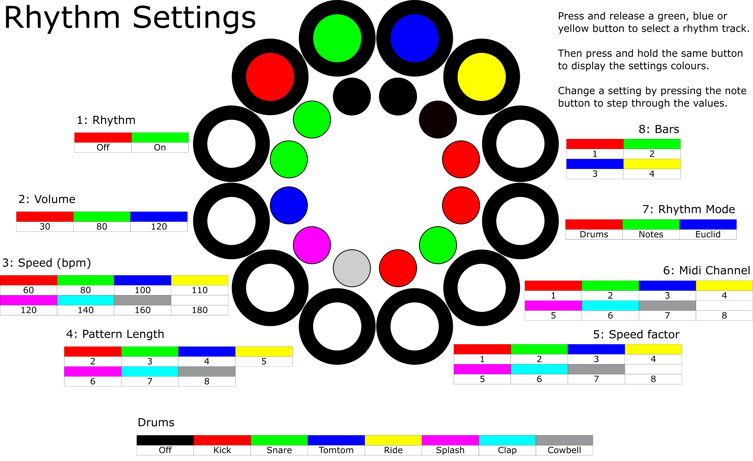
User Interface
These also took a while to draw
The show how to control the device
The coloured buttons represent recording tracks
The white buttons represent notes or steps in a sequence
The lengths of the sequences can be changed to make Euclidean rhythms

Slide 52
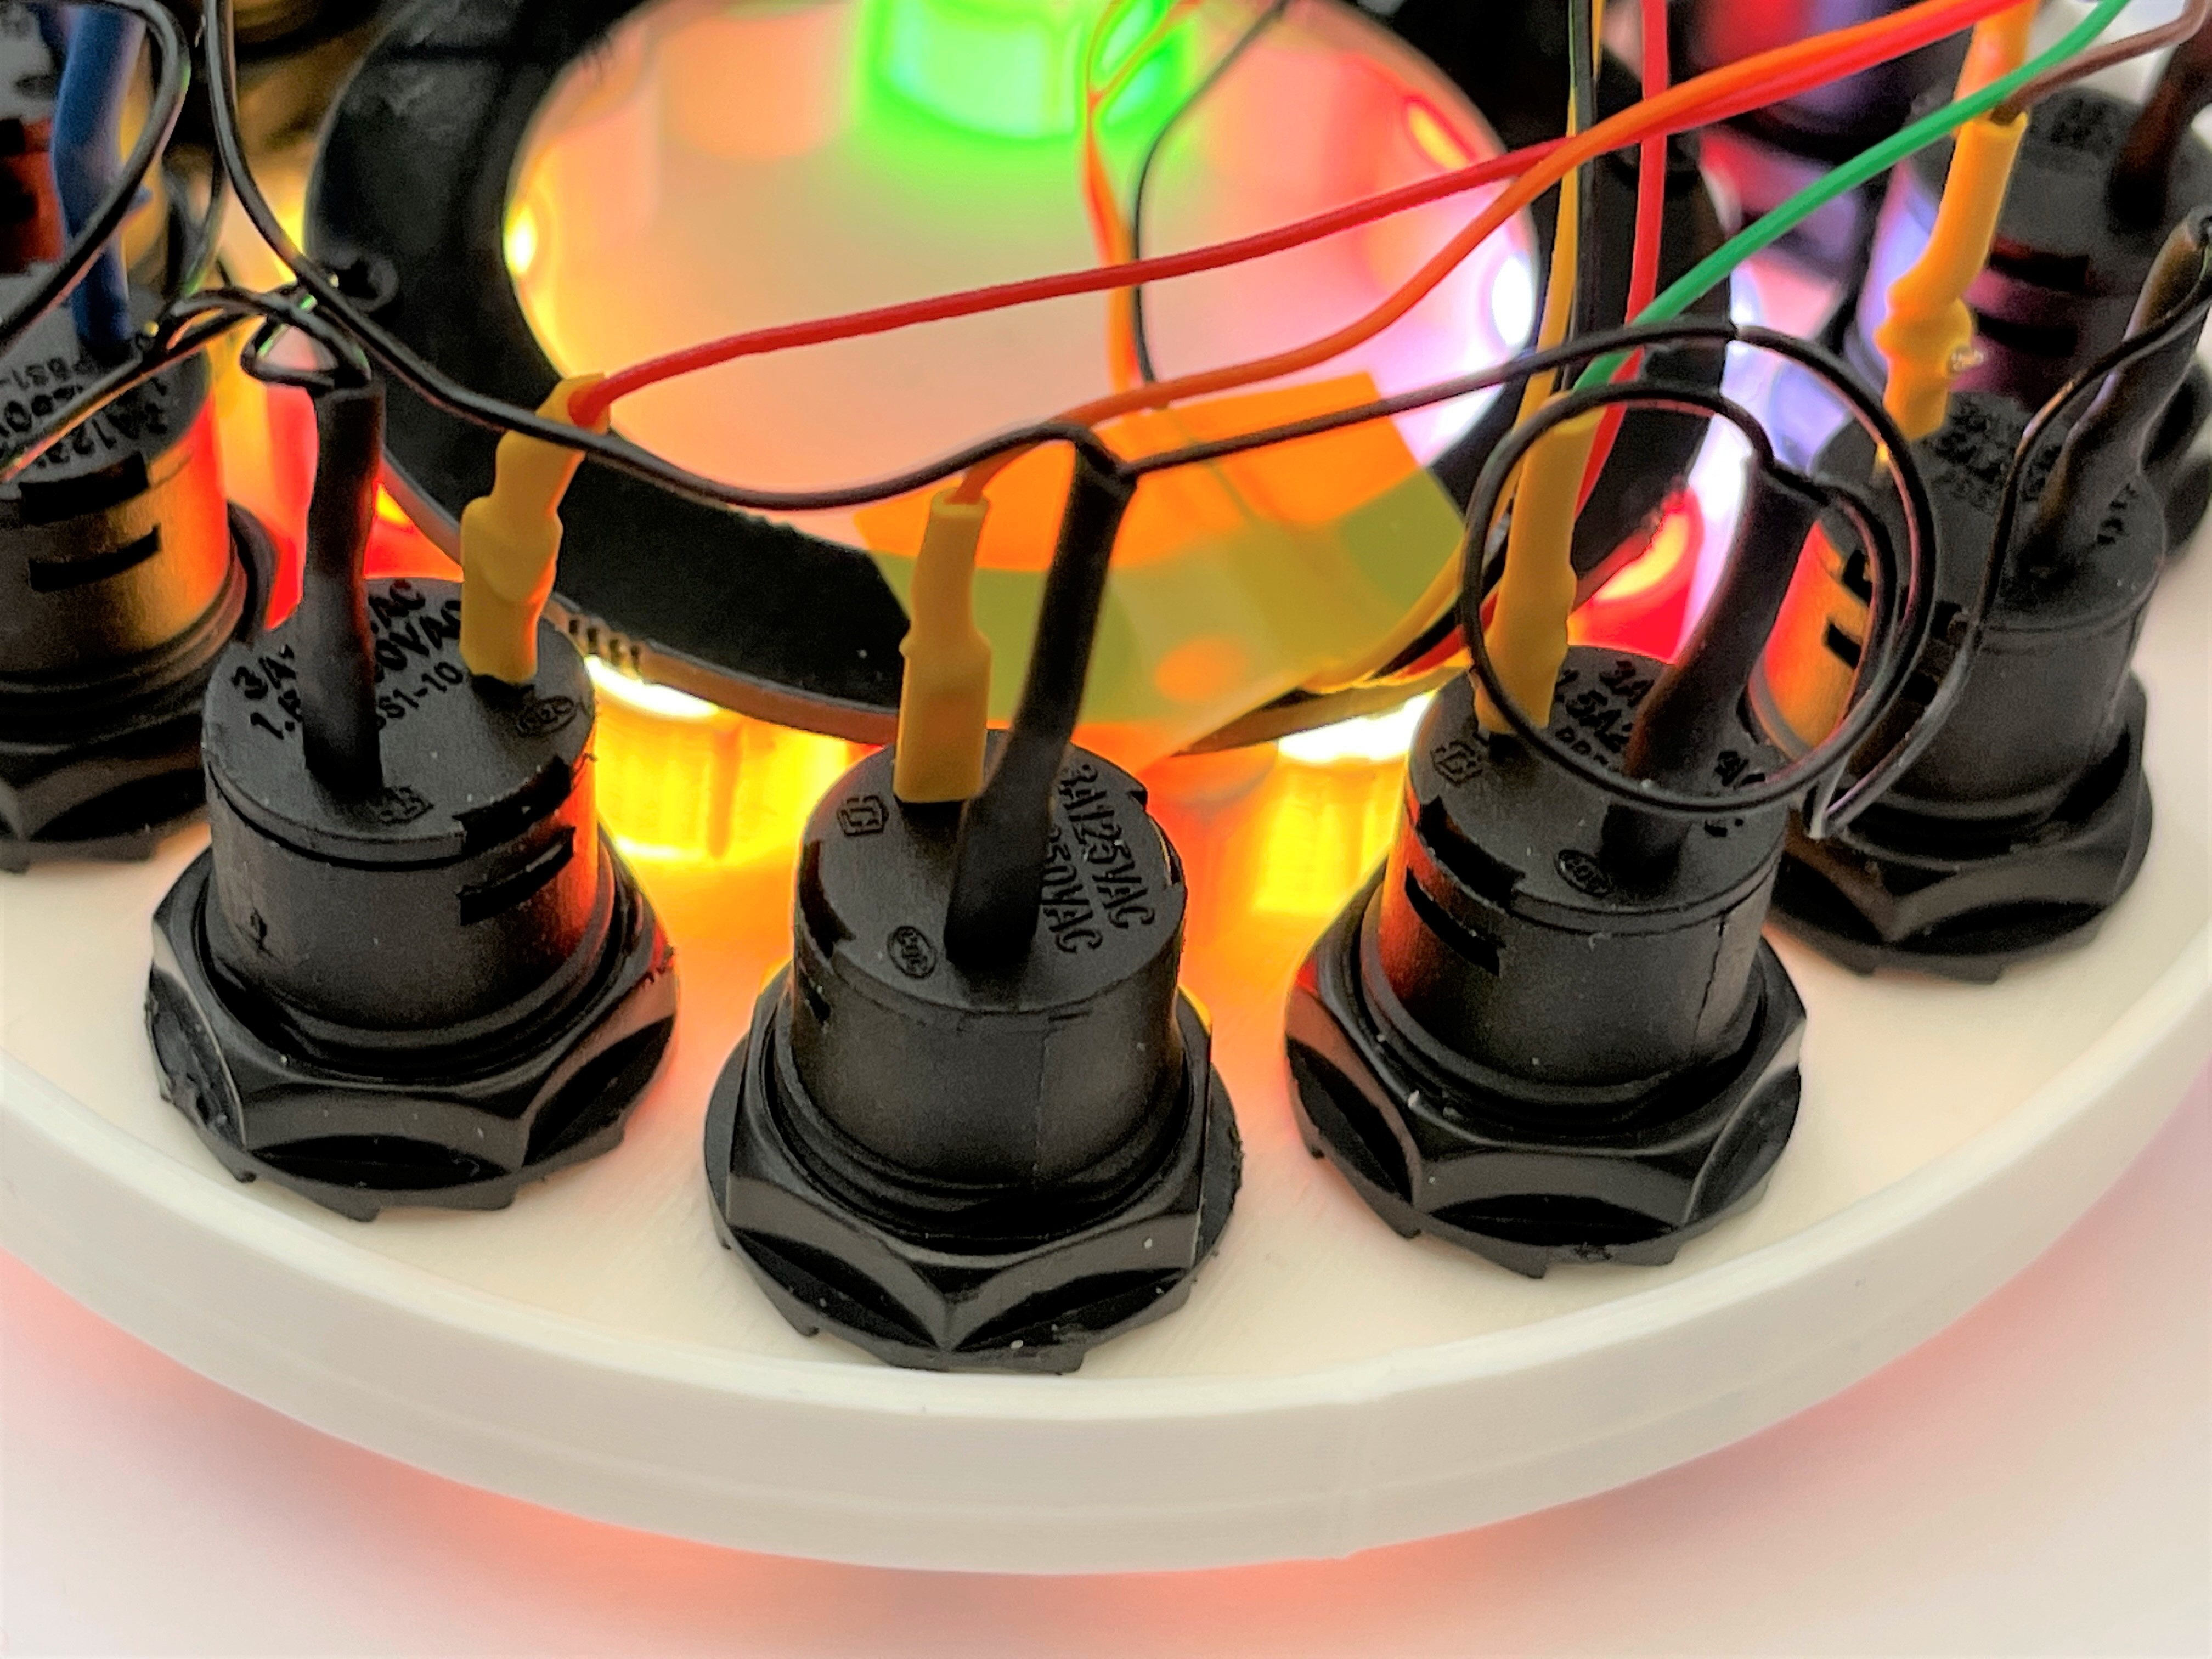
Funky sounds
Each of the three rhythm tracks can contain up to 32 steps
Each step can play a drum or a note
If we change the length of each step we can get some note patterns that precess over a long time
This can make some interesting beats
We can also create notes by summing the values on tracks to create interesting progressions

Slide 53
Demo 3: PICO Cheesebox
Making some interesting beats

Slide 54
The Crackers controller
The CheeseBox lets you create notes and rhythms but it doesn’t control the type of the sound
The Crackers controller generates MIDI control messages that can be used to change the behaviour of a Pure Data synthesizer

Slide 55
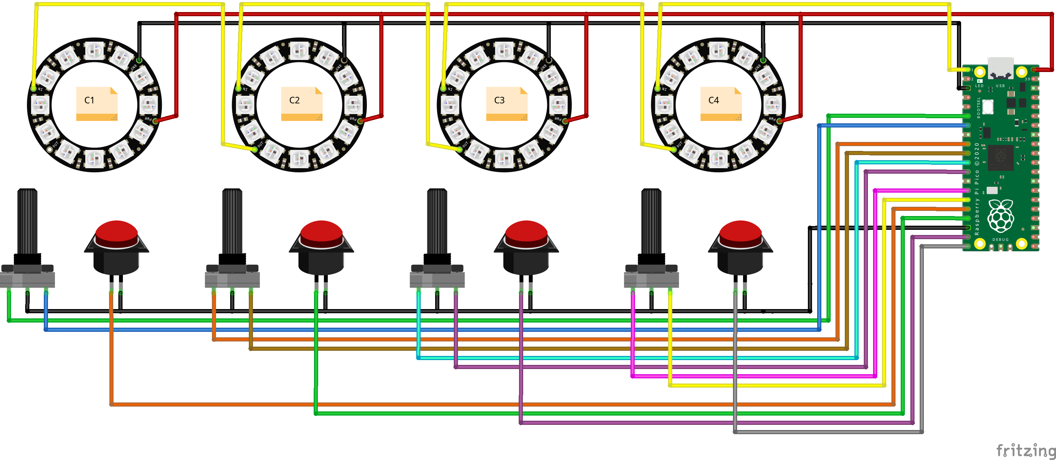
A long, thin circuit this time..
Each of the rotary controls also has a push button

Slide 56
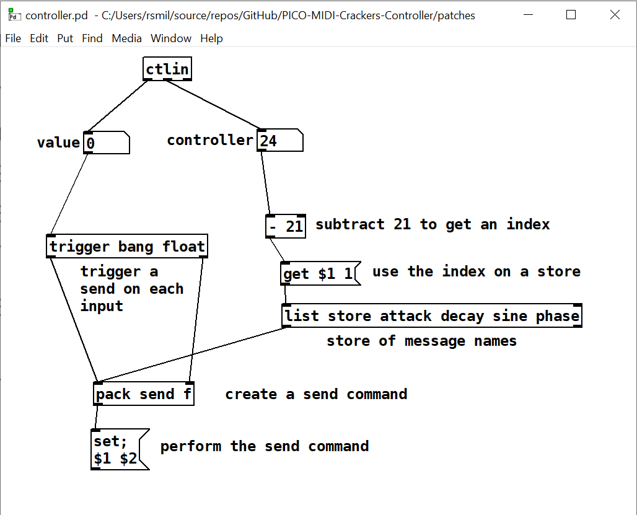
Crackers controller
The Crackers Controller has four rotary controls
These send out MIDI “control change” messages that are used to control settings in the synthesizer
We can change the level of sine and sawtooth elements of the sound, along with the attack and decay of the note

Slide 57
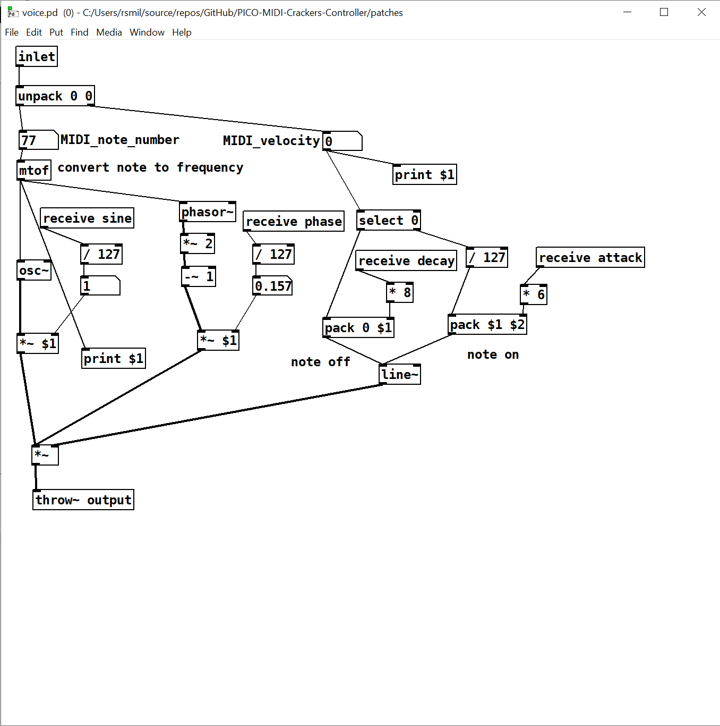
Synth Control
Messages sent from the controller patch are picked up by the voice patches and used to configure the sound output
We can watch the values change in the patch as they are received from the controller

Slide 58
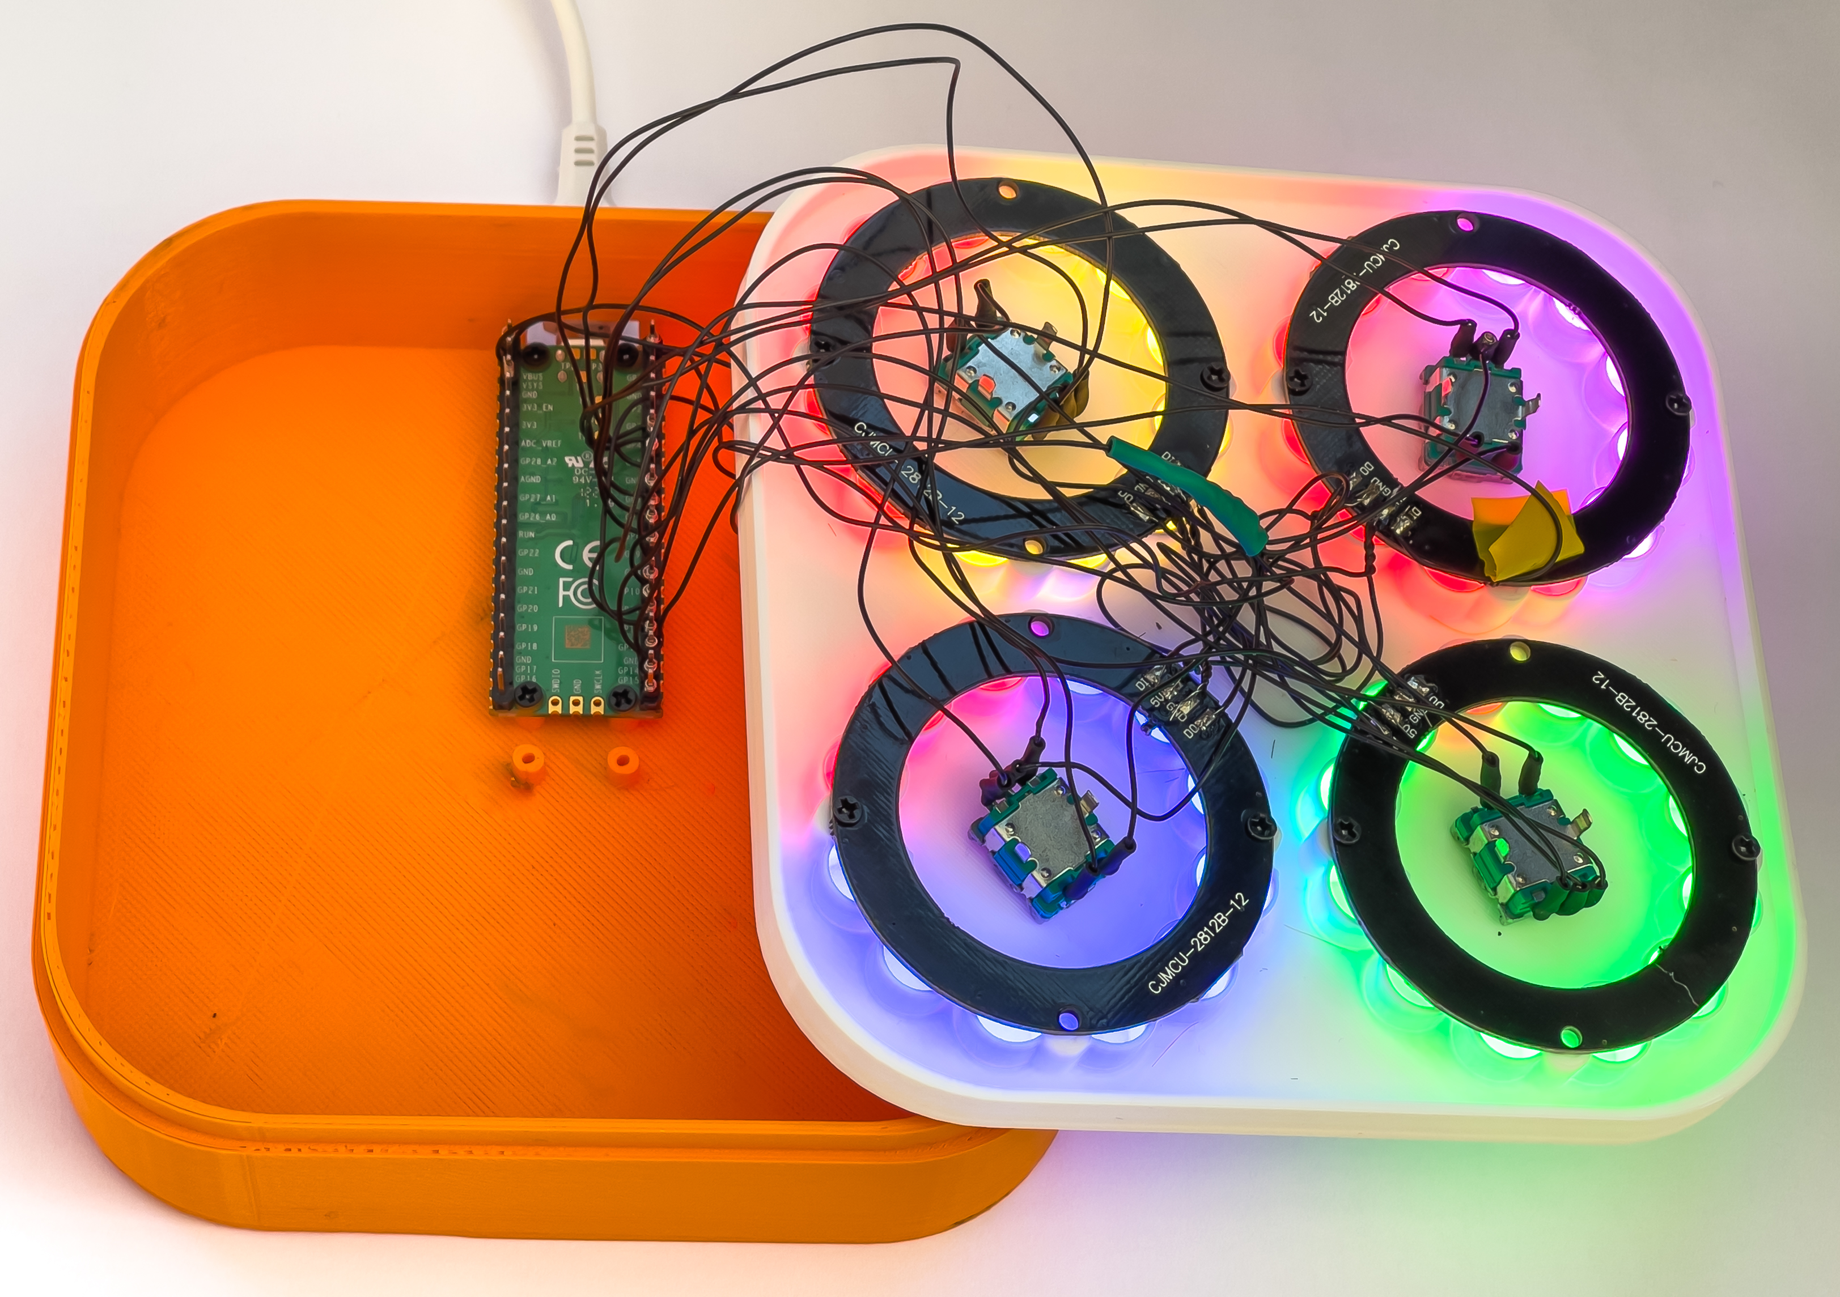
Demo 4: Crackers controller
Change the sound

Slide 59
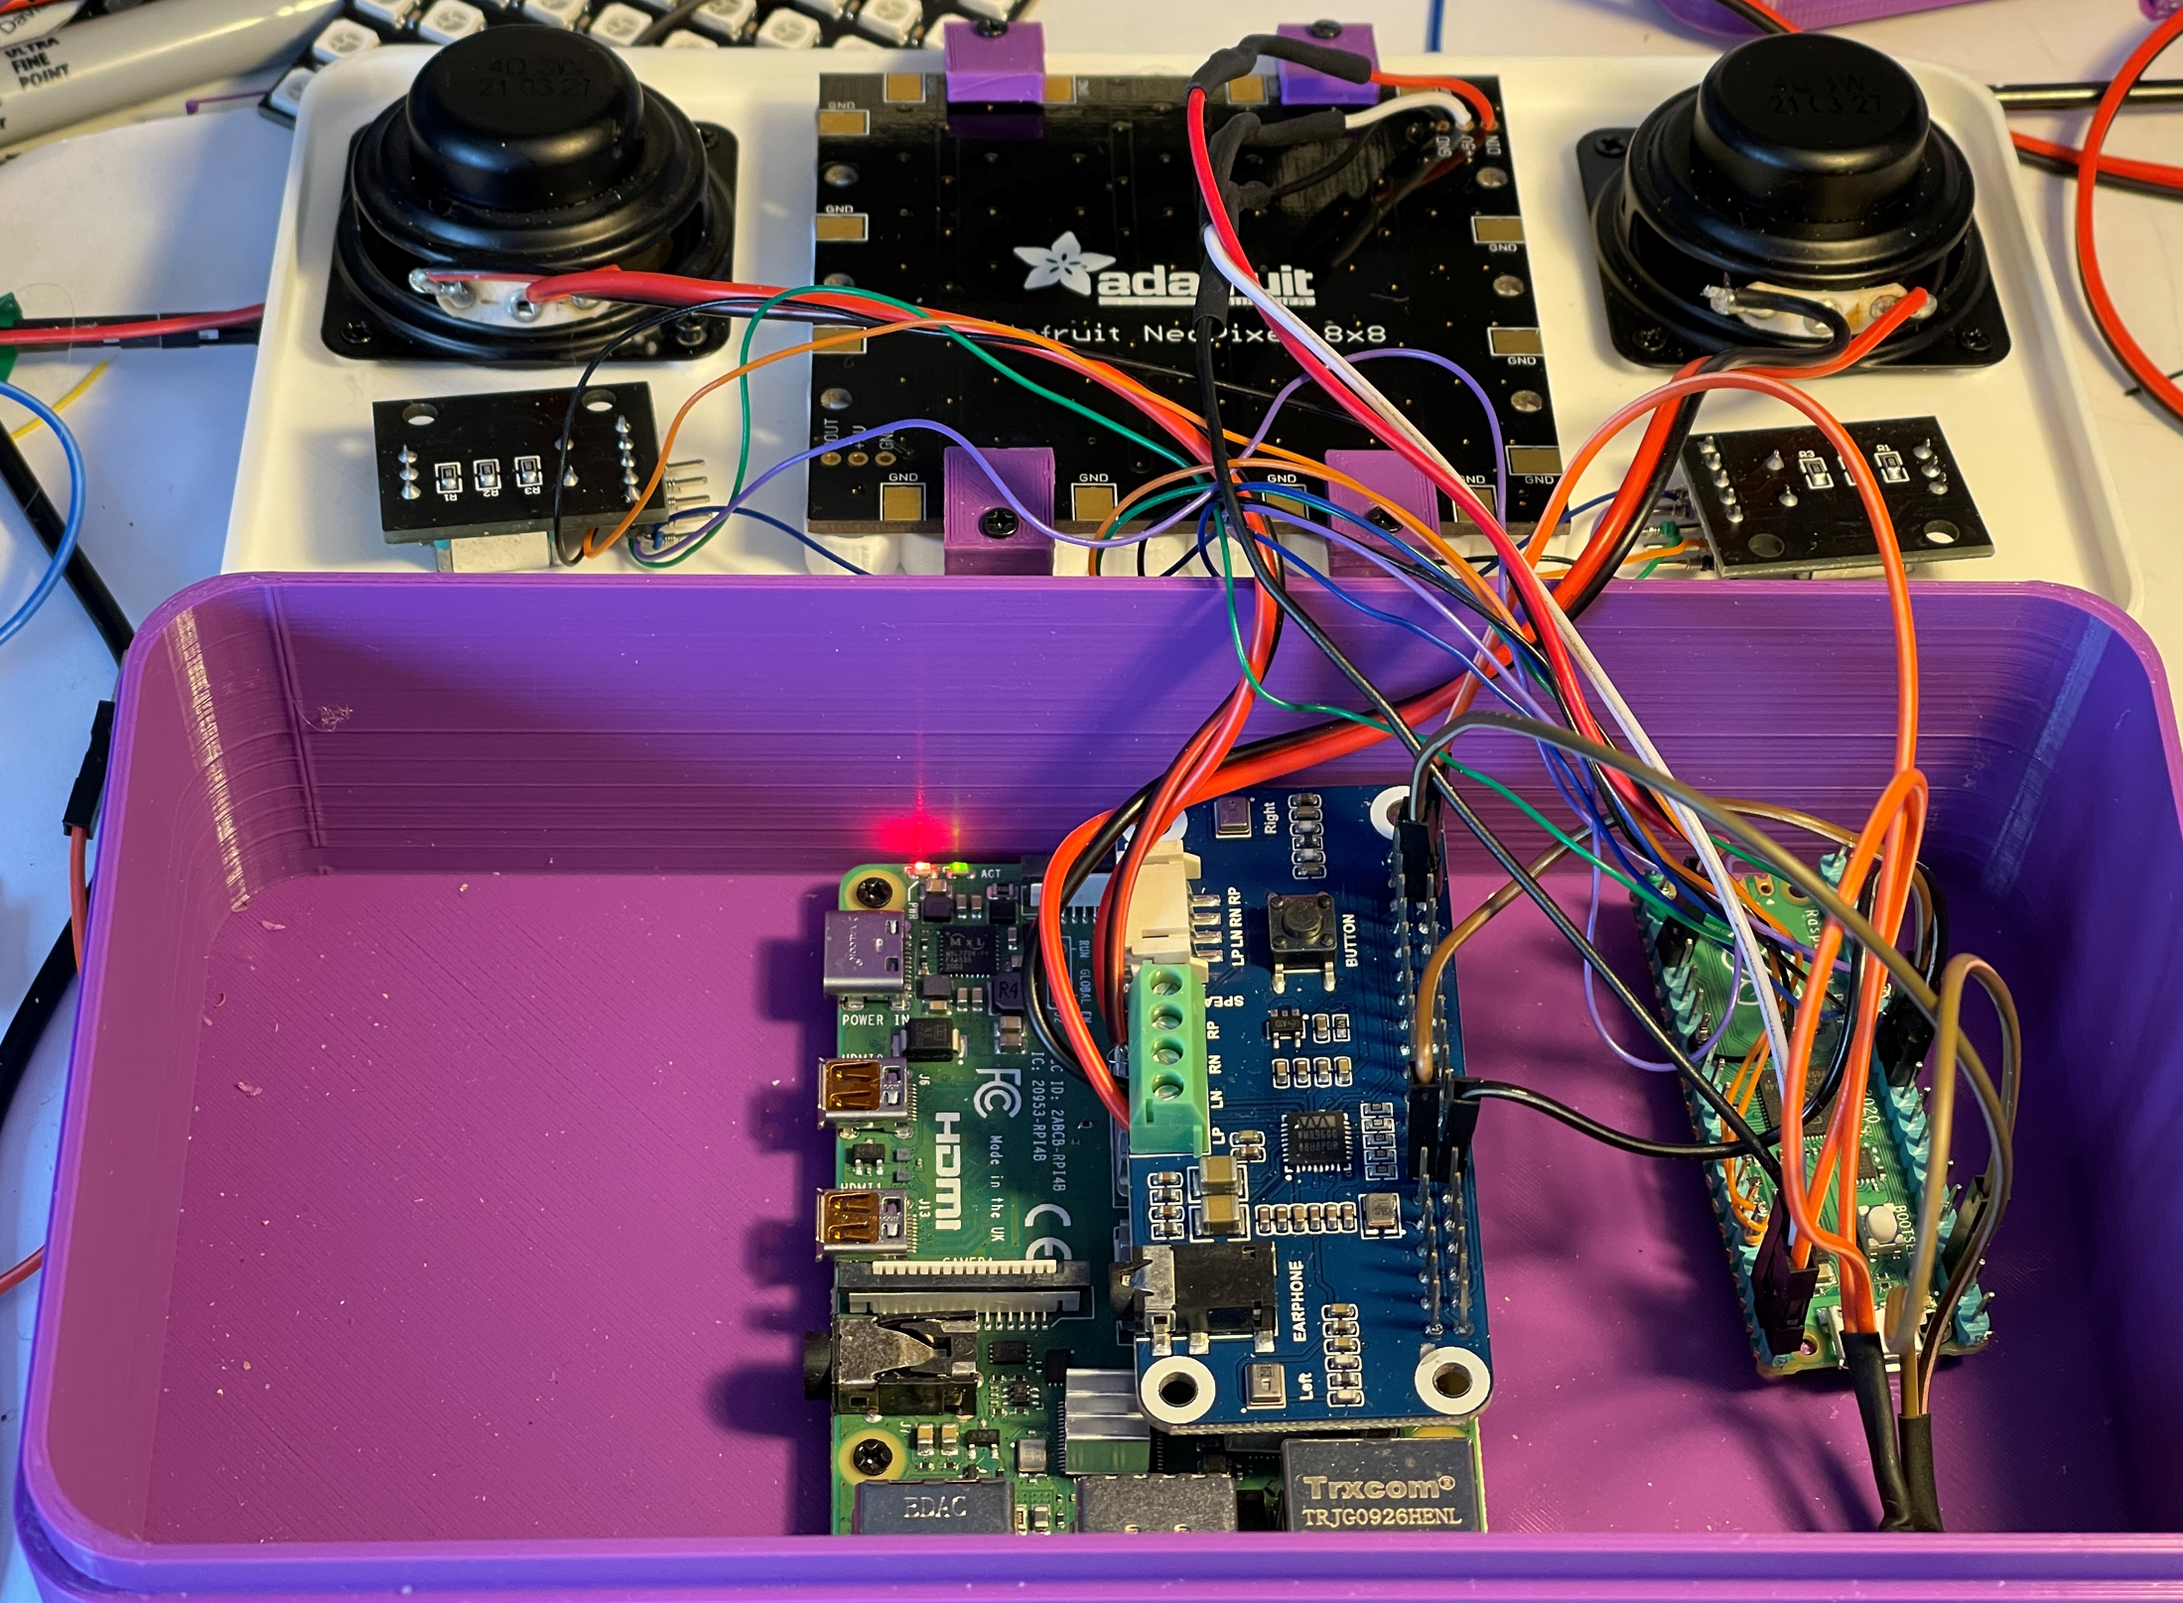
Chocolate Synthbox
You can run Pure Data on lots of PCs
But I wanted a free standing device with reasonable speakers
So I made the Chocolate Synthbox
Powered by a Raspberry Pi 4 and a PICO
The PICO looks after the controls and the screen
Us a sound-hat which provides good quality output
Which can get quite loud..

Slide 60
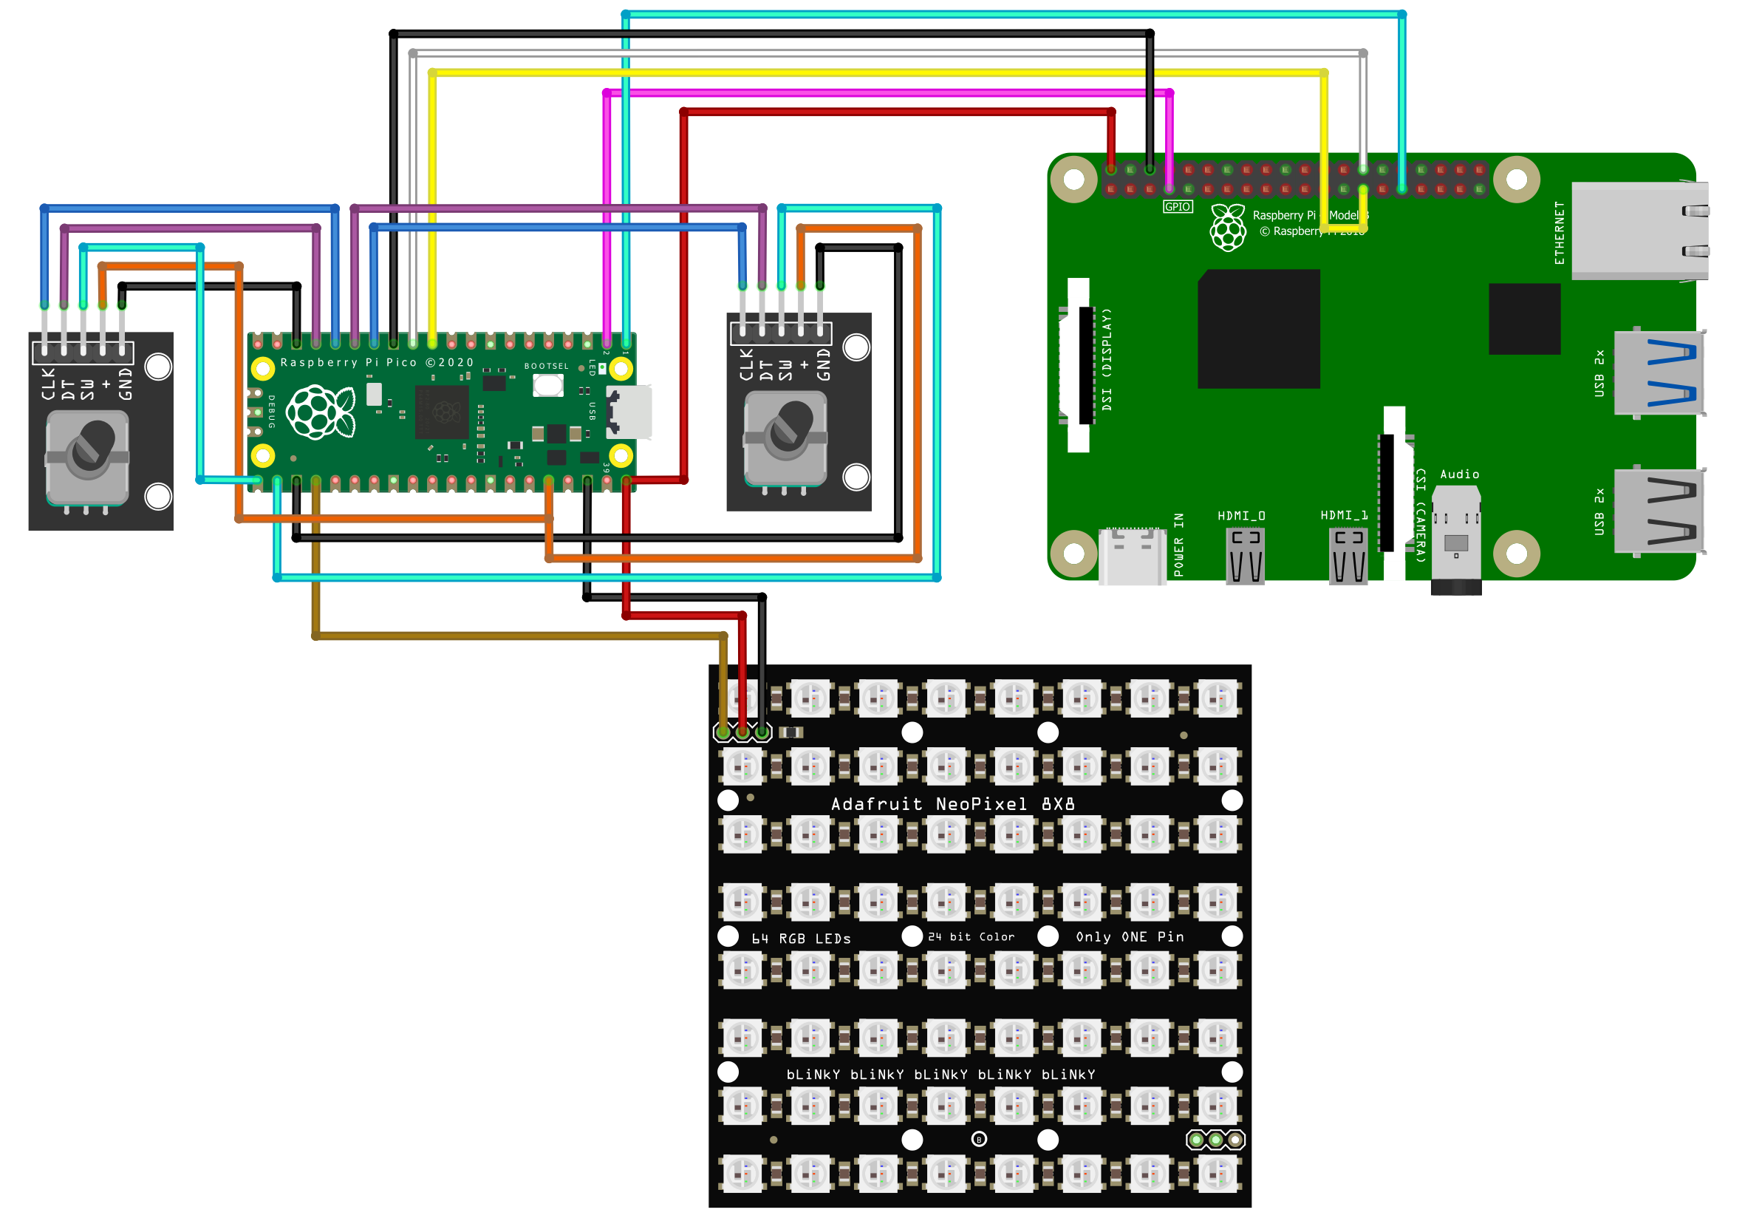
Yay! Another circuit
The PICO and the PI are linked by a serial connection
The Pure Data program sends commands for the display and receives inputs from the two rotary controllers
This is used for a bit of graphical fun

Slide 61
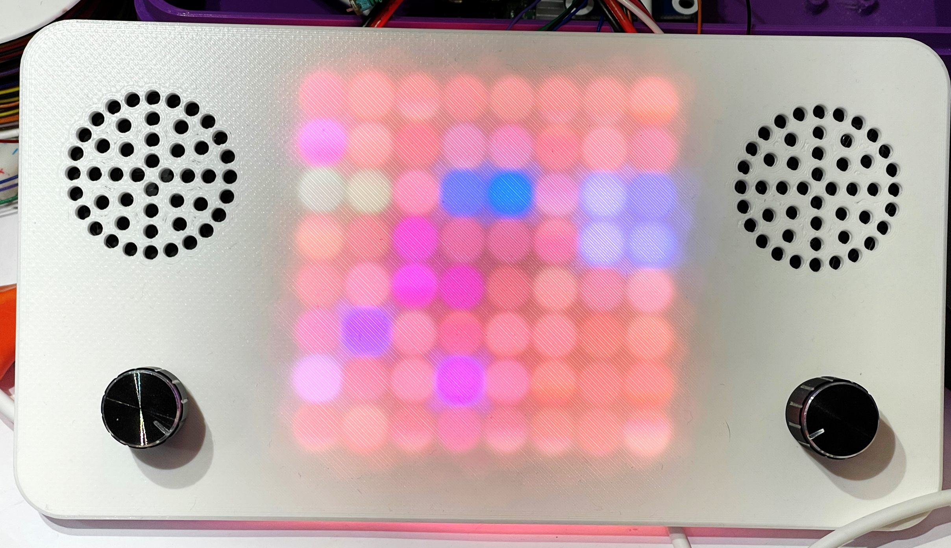
Coloured Lights
Coloured lights were not originally part of the plan
But once I had the panel…..
The lights are trigged by notes on the 3 rhythm tracks
They are hard-wired at the moment but will be configurable later

Slide 62
Demo
Time for a bit of fun with the hardware

Slide 63
Summary
You should buy my books and reads my articles
Pure Data is a graphical environment that you can use to create unique sounds – and learn a new way to create programs
The Raspberry Pi PICO is a great way to create embedded applications – and you can use Python to do it
The MIDI standard allows you to connect devices and pass note and control messages
www.robmiles.com

